Slide 1


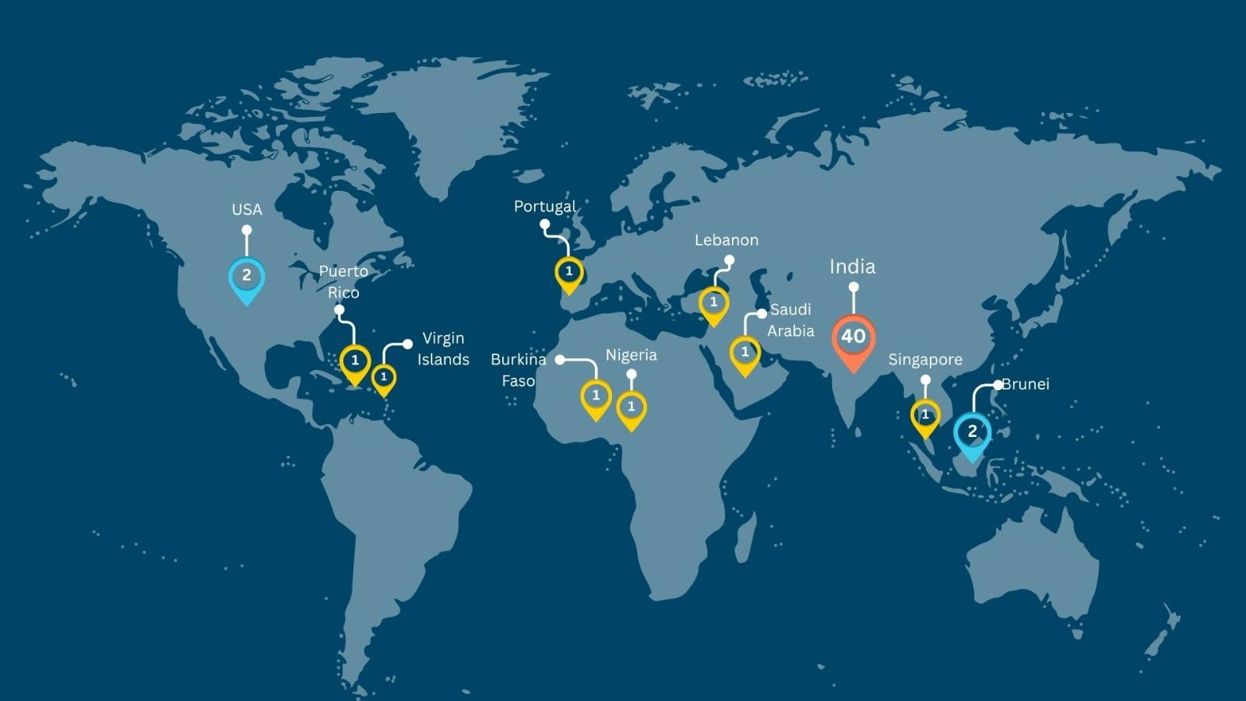
STEM & AI Educators
Upskilling Program
WEEK 2
DATE: 8th August
Presented By:
Academic Lead: Ronak Jogeshwar
Teaching Fellow: Muskan Rajak
Program Manager: Shivani Mahto

Slide 2
CASE STUDY
Case Study: AI in Classroom
VIDEO:
https://youtu.be/VL7GaFxI6Tc?si=PWZSQyf_GFOinhlD
SUMMARY
- China is integrating AI into schools through national policies, introducing AI-powered tools, robots, and interactive learning to prepare students for an AI-driven future.
- AI supports personalized learning, enhances classroom engagement, and assists teachers in delivering more effective instruction.
- The initiative emphasizes AI literacy, computational thinking, and responsible AI use to equip students with future-ready skills.
INSIGHTS
- AI is most effective when used to augment teachers, enabling more personalized and engaging learning rather than replacing human instruction.
- Large-scale AI adoption in education requires a combination of technology, teacher training, and supportive policies to create meaningful learning outcomes.

Slide 3


Slide 4

The AI Thinking Cycle
IMPLEMENT
THINK
IMPROVE
ASK AI
EVALUATE

Slide 5
Thinking With AI
Not Delegating Thinking to AI
AI should help you
Ask better questions
Explore ideas
Compare perspectives
Improve thinking
Not
Replace reasoning
Make decisions for you
Delegate cognition

Slide 6
Directions
Discuss the problem as a group
Use AI to brainstorm ideas or gain new perspectives
Review and refine AI's suggestions
Present your final solution

Slide 7
Breakout Room
Activity Duration: 10 Minutes

Slide 8
PROMPT
How to think with AI and not delegate cognition to AI?

Slide 9
Discussion
Activity Duration: 5 Minutes

Slide 10




DACI Framework for School
DECISION MAKER
ADVOCATE
COLLABORATOR
INFLUENCER
The school leader who approves and signs off on the initiative.
The person who introduces the idea and drives it forward step by step.
People who work with the Advocate to plan and implement the initiative.
Individuals who build awareness, encourage participation, and engage others.

Slide 11
Why DACI?
DACI helps educators
Clarify roles and responsibilities
Improve collaboration
Reduce confusion
Implement change successfully

Slide 12
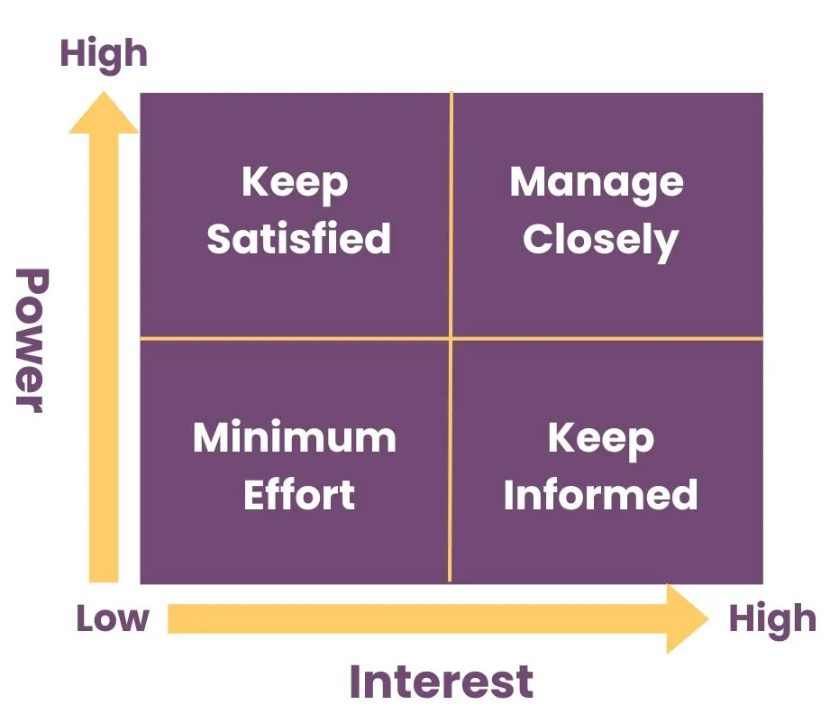
MENDELOW’S
STAKEHOLDERS
MAP
Keep
Satisfied
Key
Players
Minimal Effort
Keep
Informed

Slide 13
Mendelow’s Stakeholder Map
Keep Satisfied
Key Players
Keep Informed
Minimal Effort
High Power, Low Interest
- Keep them satisfied with key updates.
- Involve them when major decisions are needed.
e.g., School Management, Trustees, School Board
High Power, High Interest
- Involve them closely in planning and decisions.
- Engage them throughout the project.
e.g., Principal, AI Program Lead, Academic Coordinator
Low Power, High Interest
- Share regular updates.
- Encourage feedback and participation.
e.g., Teachers, Students, Parents, Support Staff
Low Power, Low Interest
- Monitor with minimal communication.
- Engage only when necessary.
e.g., External Vendors, Alumni, Visitors

Slide 14
CASE STUDY
Case Study: The Power of Negotiation
VIDEO:
https://www.youtube.com/watch?v=7FwI-U50dzc&t=3s
SUMMARY
- The video explains that negotiation is a critical professional skill used to resolve conflicts, make decisions, and create mutually beneficial outcomes in the workplace.
- It highlights three essential negotiation skills: Effective communication, Emotional Intelligence, and Value Creation, emphasizing that successful negotiations require understanding both your own and the other party's interests.
- Rather than viewing negotiation as a competition, the video encourages a collaborative approach that builds trust, strengthens relationships, and leads to sustainable agreements.
INSIGHTS
- Effective negotiation is driven by thorough preparation and active listening, enabling professionals to identify shared interests and make informed decisions.
- The best negotiations create win-win outcomes, fostering long-term relationships instead of focusing solely on short-term gains.

Slide 15


Slide 16
Studio Objectives
During Today's Studio
Practice thinking alongside AI.
Build a DACI map.
Understand stakeholder roles.
Negotiate implementation.
Plan AI adoption for your school.

Slide 17
Breakout Room
Activity Duration: 40 Minutes

Slide 18
Directions
Who are the stakeholders?
Why would they resist AI?
What is the role of each identified stakeholders in the Map.

Slide 19

PROMPT
Create a DACI map for your institution by identifying the Decision Maker, Advocate, Collaborators, and Influencers involved in implementing the solution.
Identified Stakeholder
-
-
-
-
-
-
-
-
KEEP SATISFIED
KEY PLAYERS
Sticker Pack
MINIMUM EFFORT
KEEP INFORMED

Slide 20
4-Way Negotiation Simulation
Each Team assigns
School Management -
Makerspace Incharge -
Student -
Parent -
Observers 1 & 2-
Other Stakeholders -
Problem : Agree on an AI implementation strategy in your institution.

Slide 21
Negotiation Questions
Discuss:
What are your priorities?
What concerns do you have?
What compromises are needed?
What support is required?
Notes:
Observer will make notes and insights, jotting down the final discussion; they will present the discussion of their group

Slide 22
Discussion
Activity Duration: 10 Minutes

Slide 23
Reflections
Complete these statements:
Before today, I thought…
Now I think…
My next step is…

Slide 24
Schedule Update
Next week's Saturday session has been rescheduled to Friday due to India's Independence Day celebrations.
We look forward to seeing you on Friday instead!

Slide 25

Announcement
📍 For community members based in Delhi NCR:
I'm delighted to share that I'll be joining the 11th edition of the #GSDP Conversation Series as one of the speakers.
The Green and Sustainable Development Partnership (GSDP) between India and Germany brings together diverse voices to exchange ideas and foster meaningful conversations on sustainable development.
📅 Date: 12 August 2026
🕔 Time: 5:00 PM IST
📍 Venue: German Embassy, New Delhi
If this topic interests you or someone in your network, I'd love for you to join us.
Register here: https://lnkd.in/gyUwiPue

Slide 26
GUIDELINES
Assignment Submission
Please follow these guidelines while submitting your assignments:
Submit by Wednesday, 11:59 PM (IST), unless notified otherwise.
Upload your assignment slides after the Assignment template in corresponding lecture slides shared with you, following the prescribed format.
Ensure submissions are complete, clearly named, and on time.
Include your Name, UID, Elective, and team details (as applicable).
Clearly define your Theme/Problem Statement.
Keep a personal backup of all submitted files.
Report any technical issues before the submission deadline.
NOTE: Copy the Assignment Template to work on it. Do not work on the given template.

Slide 27
Assignment 3a Template
Create a one-slide “My Learning Design Philosophy” note connecting learner needs, program design, and school systems.
Add your answer here…

Slide 28
Assignment 3b Template
Upload your organizational chart and DACI stakeholder map.
Add your answer here…

Slide 29
CASE STUDY
Case Study: The Power of Negotiation
VIDEO:
https://www.youtube.com/watch?v=7FwI-U50dzc&t=3s
SUMMARY
- The episode uses relatable everyday situations to teach children that negotiation is about listening, communicating respectfully, and finding solutions that work for everyone.
- Through storytelling, the characters demonstrate how conflicts can be resolved peacefully by understanding different perspectives instead of arguing.
- It highlights negotiation as an essential life skill that strengthens teamwork, decision-making, and healthy relationships.
INSIGHTS
- Negotiation is most effective when it focuses on mutual understanding and collaboration, rather than winning or losing.
- Teaching negotiation skills from an early age helps children develop empathy, communication, and conflict-resolution abilities that are valuable throughout life.
7

Slide 30


