Slide 1
Designing Learning Experiences with AI
Learning happens through
Experiences!

Slide 2
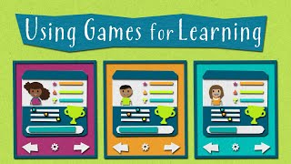

Slide 3
OUTCOMES
Learning Outcomes
Simulation
Explore Unplugged activities
Discover classroom resources
Design engaging experiences

Slide 4
What Makes a Good AI Learning Experience?
An effective AI learning experience should:
Be learner-centered.
Encourage curiosity and exploration.
Simplify complex AI concepts.
Promote active participation.
Connect AI to real-life situations.
Notes:
Reflect real-world challenges with evolving needs.
Require understanding people, not just technology.
Encourage collaboration across diverse perspectives.
Demand experimentation and iterative improvement.
Balance innovation with ethics and sustainability.
Reflect real-world challenges with evolving needs.
Require understanding people, not just technology.
Encourage collaboration across diverse perspectives.
Demand experimentation and iterative improvement.
Balance innovation with ethics and sustainability.

Slide 5
Directions
You are planning a 3-day classroom activity for 25 students.
Divide the students into 5 groups of 5 each day.
Students should collaborate with as many different classmates as possible.
No two students can be in the same group more than once across the three days.
You have 10 minutes to brainstorm and design a simple system to solve this challenge.
Think About
How will you identify each student?
How will you create the groups for each day?
How will you ensure that pairs do not repeat?
Can you use cards, colours, numbers, symbols, fruits, letters, or another simple system?
Your Final Output
Show:
Day 1: 5 groups × 5 students
Day 2: 5 groups × 5 students
Day 3: 5 groups × 5 students
And briefly explain how your system prevents repeated pairs.

Slide 6
Breakout Room
Activity Duration: 10 Minutes

Slide 7
PROMPT
How might we design a simple, repeatable grouping system that divides 25 students into five groups of five over three days, while ensuring that no two students are grouped together more than once? (Do not use AI, build the logic)

Slide 8
Discussion
Activity Duration: 5 Minutes

Slide 9
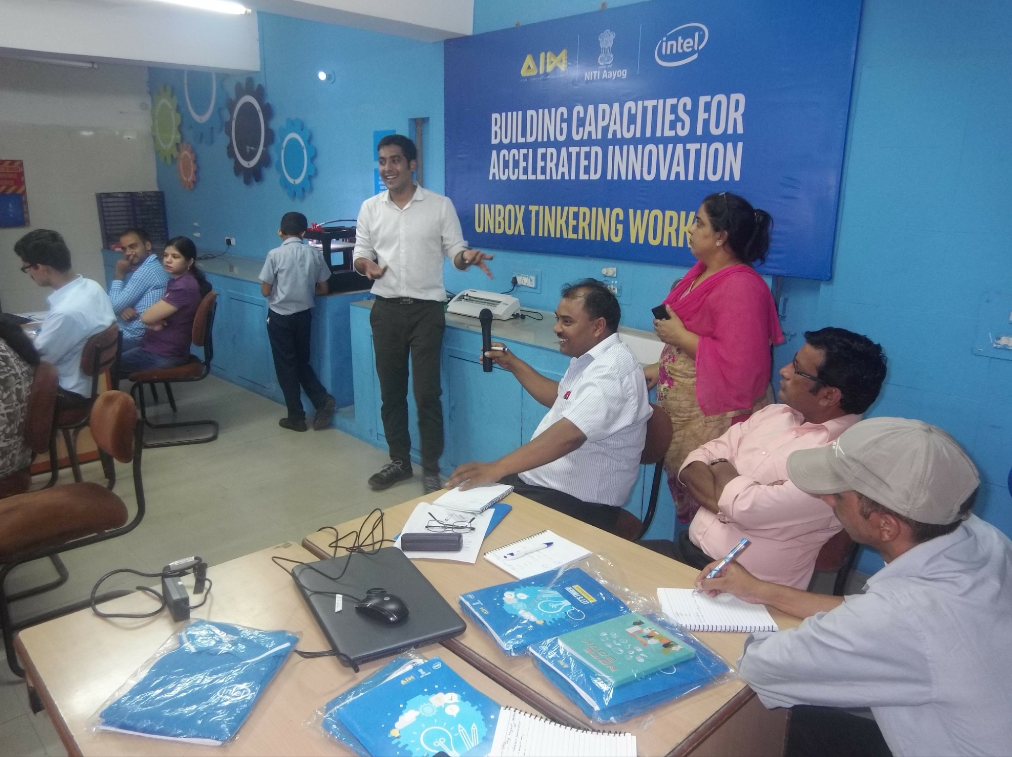

Slide 10
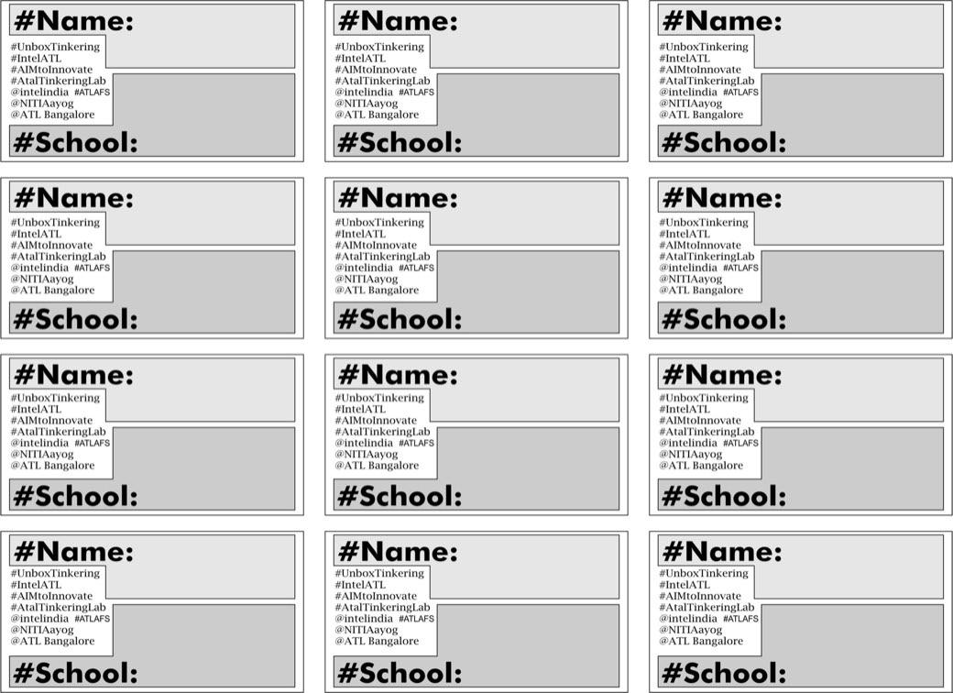

Slide 11
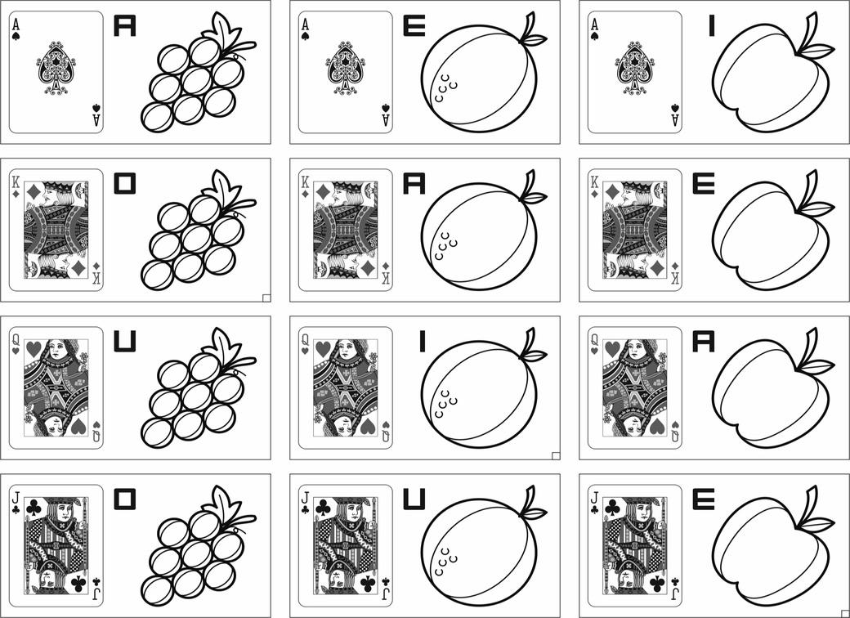

Slide 12
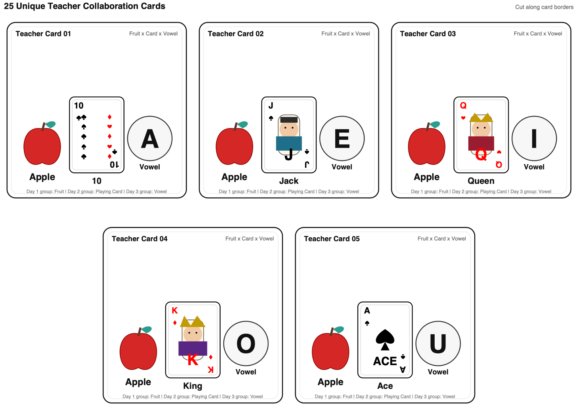

Slide 13


Slide 14
How to Play
Train your Animal AI
Observe
Look carefully at all the animal stickers
Find the Pattern
Compare the expressions of animals that hurt and do not hurt.
Identify
Identify the combination of expressions that predicts the outcome.
Test Your Rule
Test your pattern on new stickers.
Discuss
Discuss what this teaches us about data, patterns, prediction, and machine learning.

Slide 15
Breakout Room
Activity Duration: 20 Minutes

Slide 16
MONKEY

Slide 17
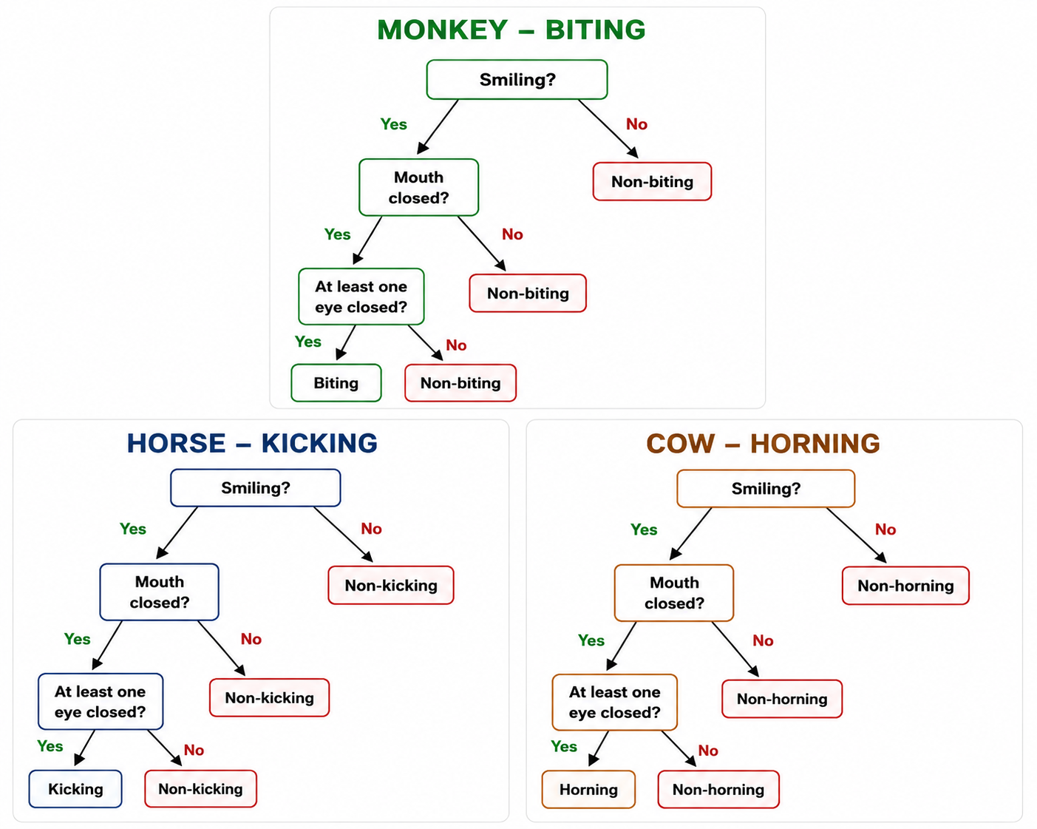
Decision Trees

Slide 18
GROUP 1
Identify the combination of expressions that predicts which monkey will bite.
Monkey will bite
Monkey will not bite

Slide 19










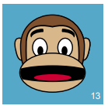

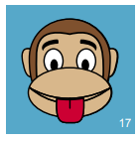
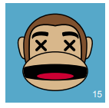





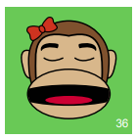
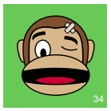
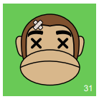
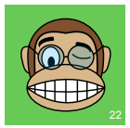
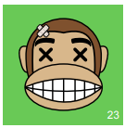
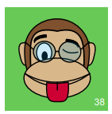
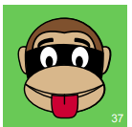
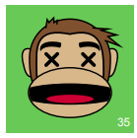
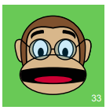
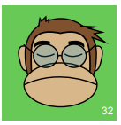

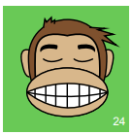
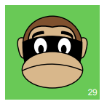
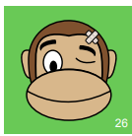
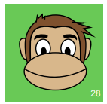
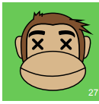
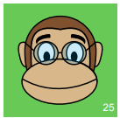
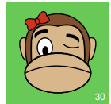

Slide 20
HORSE

Slide 21
Decision Trees

Slide 22
GROUP 2
Identify the combination of expressions that predicts which horse will kick.
Horse will kick
Horse will not kick

Slide 23
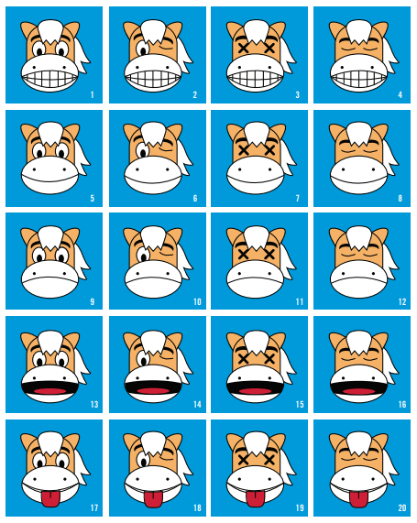

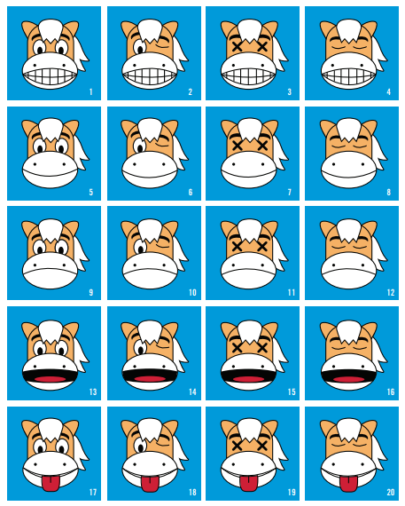
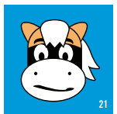












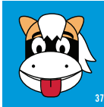



Slide 24
COW

Slide 25
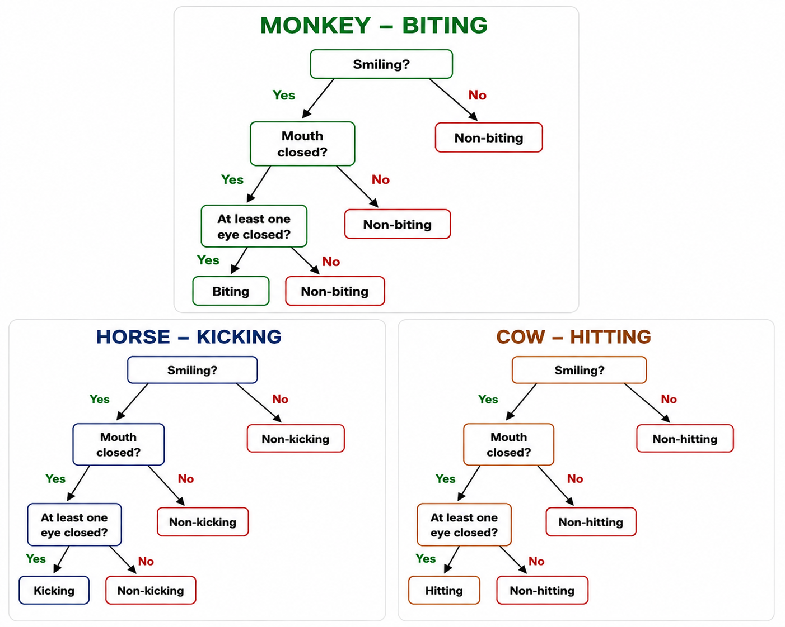
Decision Trees

Slide 26
GROUP 3
Identify the combination of expressions that predicts which cow will hit.
Cow will hit
Cow will not hit

Slide 27

























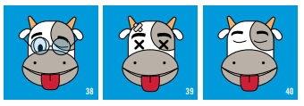

Slide 28
We will discuss more today to understand the thought process

Slide 29
Classroom Tools for Teaching AI
Learning materials include
Activity Cards
Games
Worksheets
Role-play
Reflection Journals
Story-based activities
Simulations

Slide 30
Teaching AI Concepts Through Activities
AI Concept
Classroom Example
Pattern Recognition
Spot the pattern game
Prediction
Guess the next time
Reinforcement Learning
Reward-based classroom game
Machine Learning
Classifying images or objects

Slide 31
Choosing the Right Learning Tool
Before selecting a classroom activity, ask:
What should students learn?
Which AI concept is being taught?
Is the activity age-appropriate?
Does it encourage participation?
How will learning be assessed?

Slide 32
Designing Learning Materials
Good learning materials should:
Have a clear objective.
Be simple and engaging.
Encourage discussion.
Promote collaboration.
Include opportunities for reflection.

Slide 33
AI is More Than Technology
AI education is not about coding alone.
It is about helping learners understand:
How AI works.
How AI makes decisions.
How AI affects society.
How humans should use AI responsibly.

Slide 34





Reinforcement Learning in Everyday Life
Examples include:
Learning
through rewards
Video game scoring
Traffic navigation
Recommendation
systems
Classroom reward systems
AI learns through feedback, just as humans learn through experience.

Slide 35






Exploring AI Learning Resources
Useful resources:
Suno AI
Google Flow
Raspberry Pi
Foundation
MIT RAISE
(DAILy Curriculum)
ISTE
AI Unplugged

Slide 36
Key Takeaways
AI concepts can be taught without computers.
Games and activities simplify complex ideas.
Learning materials should focus on understanding.
Good AI education develops curiosity, creativity, and critical thinking.

Slide 37
Learning Resources
The learning doesn't stop when the session ends—these resources will help you keep building your skills.
Reading
Do you have some rope? The let’s teach about AI concepts
The Developing AI literacy (DAILy) Curriculum
3 Unplugged activities for teaching about AI
Tools
Suno.ai
Google Flow

Slide 38
