Slide 1



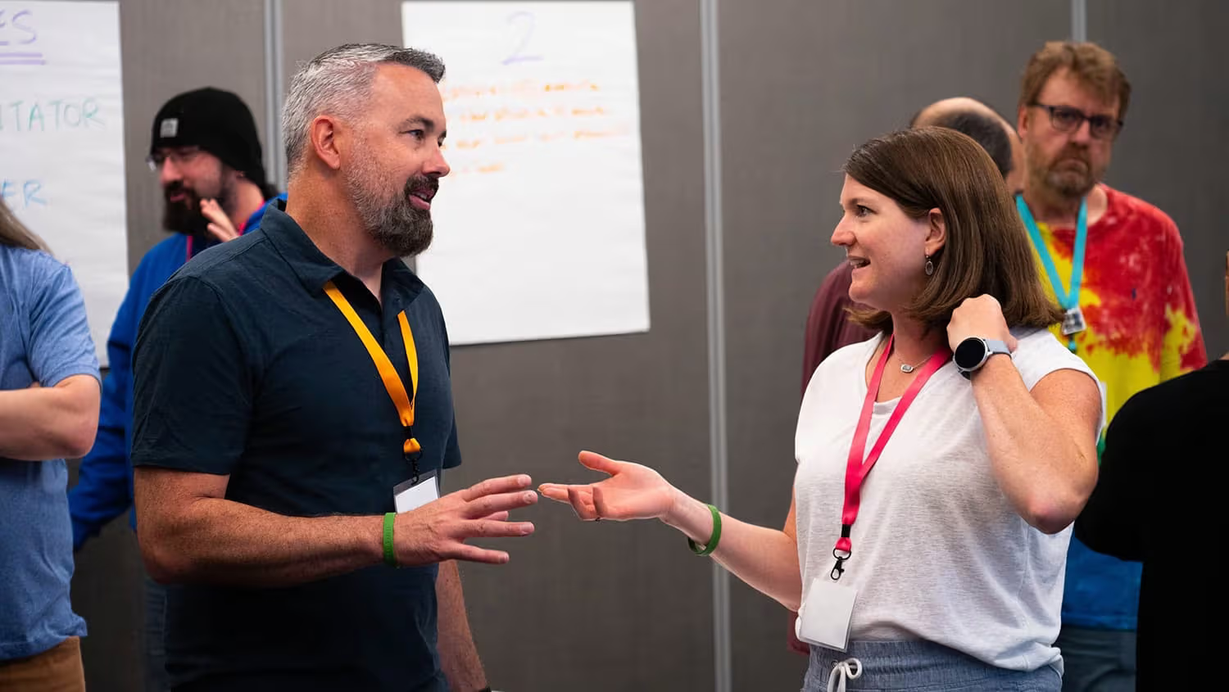
STEM & AI Educators
Upskilling Program
WEEK 4
DATE: 20th August
Presented By:
Academic Lead: Ronak Jogeshwar
Guest Speaker: Aashi Chandalia
Teaching Fellow: Muskan Rajak
Program Manager: Shivani Mahto
Notes:
0:00 | Welcome. Keep this short. One line: 'In the next hour I am going to show you, live, work that used to take an hour getting done in under two minutes — and exactly which parts you must still check yourself.' Then a quick show of hands: who has used an AI tool at least once? Who uses one most weeks? This tells you how much to explain later. Do not read the slide.

Slide 2
What Have We Learned So Far?
Let’s use this time to glance at the rear view mirror
Notes:
0:00 | Welcome. Keep this short. One line: 'In the next hour I am going to show you, live, work that used to take an hour getting done in under two minutes — and exactly which parts you must still check yourself.' Then a quick show of hands: who has used an AI tool at least once? Who uses one most weeks? This tells you how much to explain later. Do not read the slide.

Slide 3
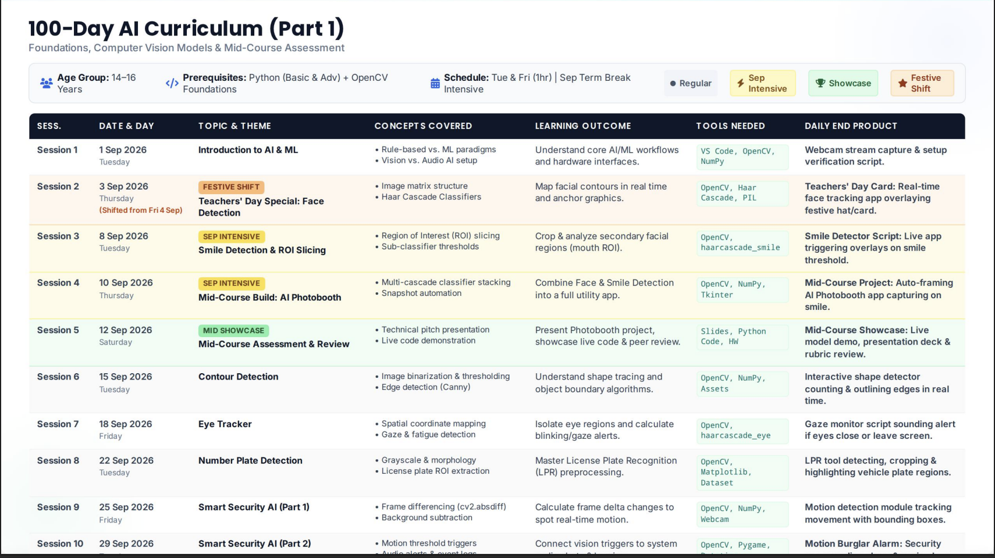
ASSIGNMENTS TILL FAR
By Priyadarshini Basu

Slide 4
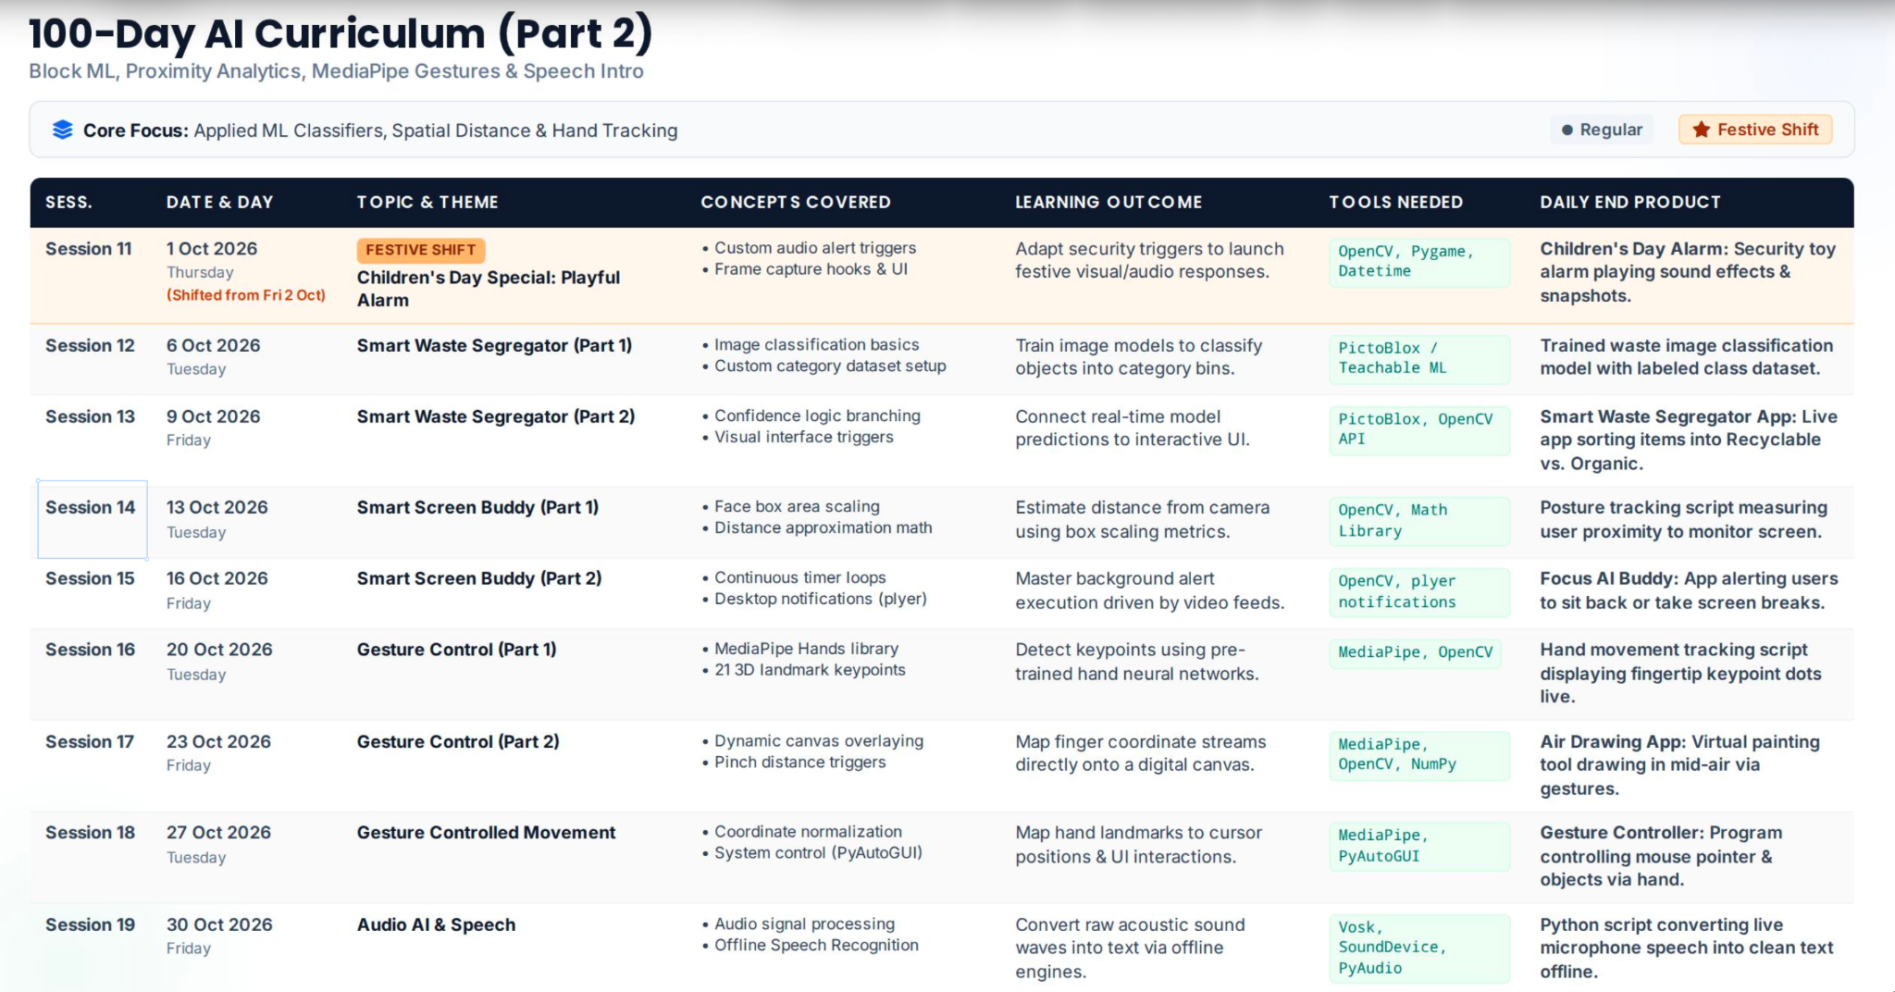
ASSIGNMENTS TILL FAR

Slide 5
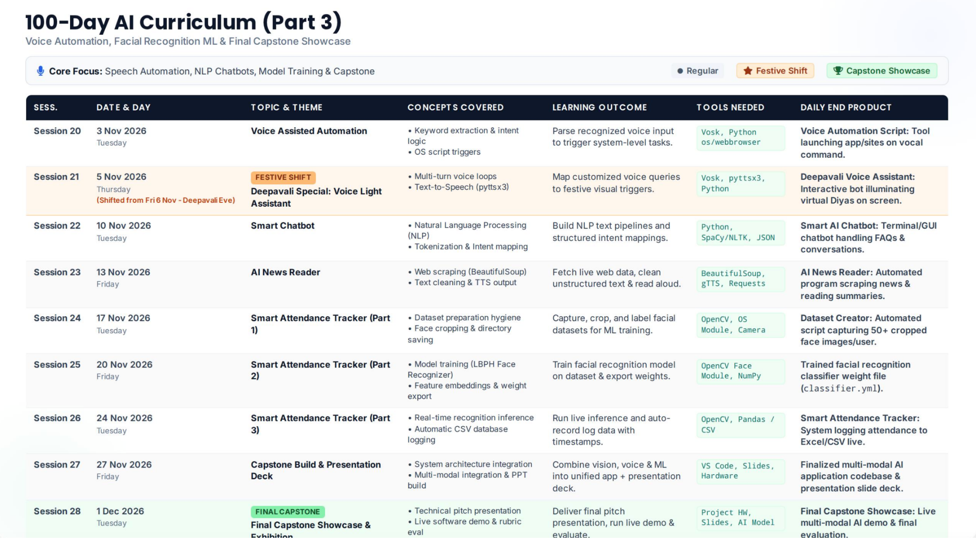
ASSIGNMENTS TILL FAR

Slide 6
ASSIGNMENTS TILL FAR
A short reflection on why dates, data, and programming discipline matter for successful implementation.
A curriculum is an argument about what matters. A calendar is the test of whether that argument can actually be made in the time available. Everything in the preceding documents that looks like administrative detail is, in practice, the difference between a programme that runs and one that is quietly abandoned in February.
Dates: Anchoring the school-age programme to the real 2026/27 calendar changed its design, not just its presentation. The Easter interruption fixed the showcase on 19 March, and that single date back-solved the whole final module: the build freeze had to fall a week earlier, user testing a week before that, and fabrication had to be finished before a print queue could swallow the schedule. Choosing Wednesday and Friday sessions was not a preference but an arithmetic result, every public holiday in the span falls on a Monday or Tuesday. Undated plans hide these collisions; they surface anyway, in week 19, as panic. A date is a commitment made early enough to still be cheap.
Data: Two kinds run through this work, and they turn out to be the same discipline. Learners are asked to log raw sensor values before deciding on a threshold, and to keep a failure log before retraining a model, measure, then decide. Teachers are asked to do exactly this at programme level: journal audits, peer assessment rounds, pilot observations of what children actually did rather than what was intended. Both refuse the temptation to conclude first and gather evidence afterwards. A programme that collects nothing can only be evaluated by how it felt, which is how weak practice persists.
Programming discipline: In Portuguese pedagogical usage programação means the disciplined sequencing of content, time and assessment, and in a STEM unit the pun is exact. Programming a robot and programming a semester demand the same habits: decompose the goal, sequence the steps, respect the constraints, test early, and expect to debug. The 2 ECTS ceiling on CAARE is a constraint of precisely this kind. Roughly two hours of independent study per week is not a detail to be worked around; it determines that production must happen in class and that the resource brief must stay small. Ignoring it does not create more time, it creates unfinished work and demoralised students.
None of this guarantees a good programme. Sound ideas can still be badly taught. But an unscheduled, unmeasured, unsequenced good idea reliably becomes nothing at all, and that failure is far more common than a failure of ambition.
By Celestino Magalhães

Slide 7



Insights by:
Aashi Chandalia
Learning Experience Designer
@Skillmatics
Alumna
@Harvard GSE

Slide 8
Play-based Learning
Why play-based learning works, what it should and shouldn't look like, and how AI can help us design it with intention.
1

Slide 9
When did you last learn something
because you wanted to?
Not because there was a test.
Play creates the conditions in which learning happens naturally.
Not because someone told you that you needed to know it.
Not because there was a certificate at the end.
But because you were curious.
2

Slide 10
Play is not a decoration we add to learning.
It is an approach to learning.
What people often think play means:
What play actually creates:
Adding a game
Curiosity to explore
Adding some animations
Agency to choose
Giving students points
Room to experiment
Putting the content into a quiz
A system worth navigating
3

Slide 11





WHY PLAY WORKS
Play gives learning five things
Curiosity
Agency
Experimentation
Emotional engagement
Feedback
"I wonder what will happen if..." — the start of inquiry.
Choice turns the learner from receiving information to constructing an experience.
Permission to try something, fail, change strategy, and try again.
We remember experiences we feel.
The system responds — closer, that didn't work, try again, unlocked.
Curious → acting → receiving feedback → adapting → trying again. That's a learning cycle.
PLAY AS PEDAGOGY
4

Slide 12
THE MINDSET SHIFT
Ask a different question
OLD QUESTION
NEW QUESTION
"How can I make this lesson more playful?"
"How can I give the learner something meaningful to do?"
Play doesn't require toys, movement, or laughter. A five-year-old building a tower is playing. So is a teenager designing a city in Minecraft, students arguing about surviving on Mars, or a medical student running an emergency simulation.
PLAY AS PEDAGOGY
5

Slide 13




DESIGN PRINCIPLES
Don't ask “does this look playful?”
Ask: does this create the conditions for playful behaviour?
Choice
Challenge
Uncertainty
Can I make decisions?
Is there something I'm trying to accomplish?
Do I know exactly what will happen?
Experimentation
Feedback
Consequence
Can I try different approaches?
Does the environment respond to what I do?
Do my decisions actually matter?
6

Slide 14
Teaching climate change
TRADITIONAL
THROUGH PLAY
A presentation
Students lead a fictional city with a limited budget: invest in public transport? Build a coal plant? Subsidize EVs? Protect a forest?
Causes of climate change
Effects of climate change
A worksheet
After every decision, the world responds — pollution falls but unemployment rises; the economy grows but biodiversity declines.
A quiz
Climate change stops being a definition on a slide. It becomes a system the learner is navigating.
PLAY AS PEDAGOGY
7

Slide 15
Constraints spark creativity
Creative writing
Mathematics
Instead of "write a 500-word story," draw three cards:
Instead of "solve 15 addition problems," set a balancing challenge:
Character: An astronaut who hates space
Manipulating the numbers
Setting: A wedding
Predicting the outcome
Problem: Nobody can tell the truth
Testing a combination
Adjusting until it balances
The constraint itself creates the creativity.
The mathematics becomes a problem to solve, not a set to calculate.
8

Slide 16
THE CAUTION
What play-based learning is not
“CONFETTI LEARNING”
GAMIFICATION vs. PLAYFUL LEARNING
Take a worksheet. Add cartoon characters, stars, a progress bar, a sound effect. Call it playful.
Gamification asks:
"How can I add game mechanics to this?"
The decoration changes. The learning experience doesn't.
Playful learning asks:
"How can I redesign this so the learner is actively participating in the problem?"
More points for watching a video doesn't make it more engaging. A leaderboard on an activity nobody wants just makes the competition visible.
And play shouldn't become cognitive overload — too many rules or characters means learners spend more energy on the game than the concept.
PLAY AS PEDAGOGY
9

Slide 17
DESIGN PROCESS
The design loop
Play alone doesn't guarantee learning — we need a bridge from experience to understanding.
1
2
3
4
5
6
Learning goal
Practice
Challenge
Choice
Response
Reflection
›
›
›
›
what should the learner be able to do that they can't now?
what could they do to build that skill?
what meaningful task requires it?
what decisions can they make?
how will the environment react?
what did they notice, and why?
Experience layer: doing, exploring, experimenting. Meaning-making layer: reflecting, explaining, connecting, applying.
10

Slide 18




WHERE AI COMES IN
AI as a better design partner. Not a game generator.
The opportunity isn't more games. It's becoming better learning experience designers.
1
2
3
4
5
Brainstorming partner
Constraint generator
Rapid prototyping partner
Learner simulator
Personalization engine
Generate a wide design space of playful experiences beyond quizzes and worksheets.
Characters, missions, unexpected events, and resource limits that create dynamic systems.
Draft an activity, test it, then iterate: simplify, add failure, remove competition.
Role-play different learners — risk-averse, low working memory — to find blind spots early.
Adapt clues, complexity, and feedback in real time to how the learner is doing.
11

Slide 19
IN YOUR PROMPTS
What this sounds like in practice
“Give me 20 playful experiences where learners make choices involving opportunity cost. No quizzes or worksheets — include simulations, role-play, and storytelling.”
Brainstorm
“I'm designing a negotiation simulation for 14-year-olds. Give me 10 unexpected events that force players to rethink strategy without making it unfair.”
Constrain
“This is too complicated for a 10-year-old. Reduce the rules to three, increase learner choice, remove competition, add room for failure.”
Prototype & iterate
AI generates possibilities. The designer makes decisions.
12

Slide 20
THE CAVEAT
AI can generate an activity.
It can't know if it's good design.
Does this serve the learning objective?
Is the challenge meaningful?
Is there genuine learner agency?
Is the feedback useful?
Is failure safe and productive?
Is the cognitive load appropriate?
Does the learner know why they're doing this?
Would a real learner want to engage with this?
13

Slide 21
We don't make learning feel like play.
We make learning something worth playing with.
What could the learner explore?
What could they change, or try?
What could go wrong or surprise them?
What decisions could they make, and what would they learn from them?
14

Slide 22
Discussion

Slide 23
The Turing Test
Can a Machine Think?
The Turing Test, proposed by Alan Turing (1950), evaluates whether a machine can imitate human conversation well enough that a person cannot distinguish it from a human.
Introduced the idea of machine intelligence.
Why it Matters?
Encouraged discussion about human vs. machine thinking.
Laid the foundation for modern Artificial Intelligence.

Slide 24
MATERIAL
Learning Resources
The learning doesn't stop when the session ends—these resources will help you keep building your skills.
Reading
AI Unplugged
This reading is mandatory for this week’s Studio Session.

Slide 25

Notes:
0:00 | Welcome. Keep this short. One line: 'In the next hour I am going to show you, live, work that used to take an hour getting done in under two minutes — and exactly which parts you must still check yourself.' Then a quick show of hands: who has used an AI tool at least once? Who uses one most weeks? This tells you how much to explain later. Do not read the slide.

