Slide 1
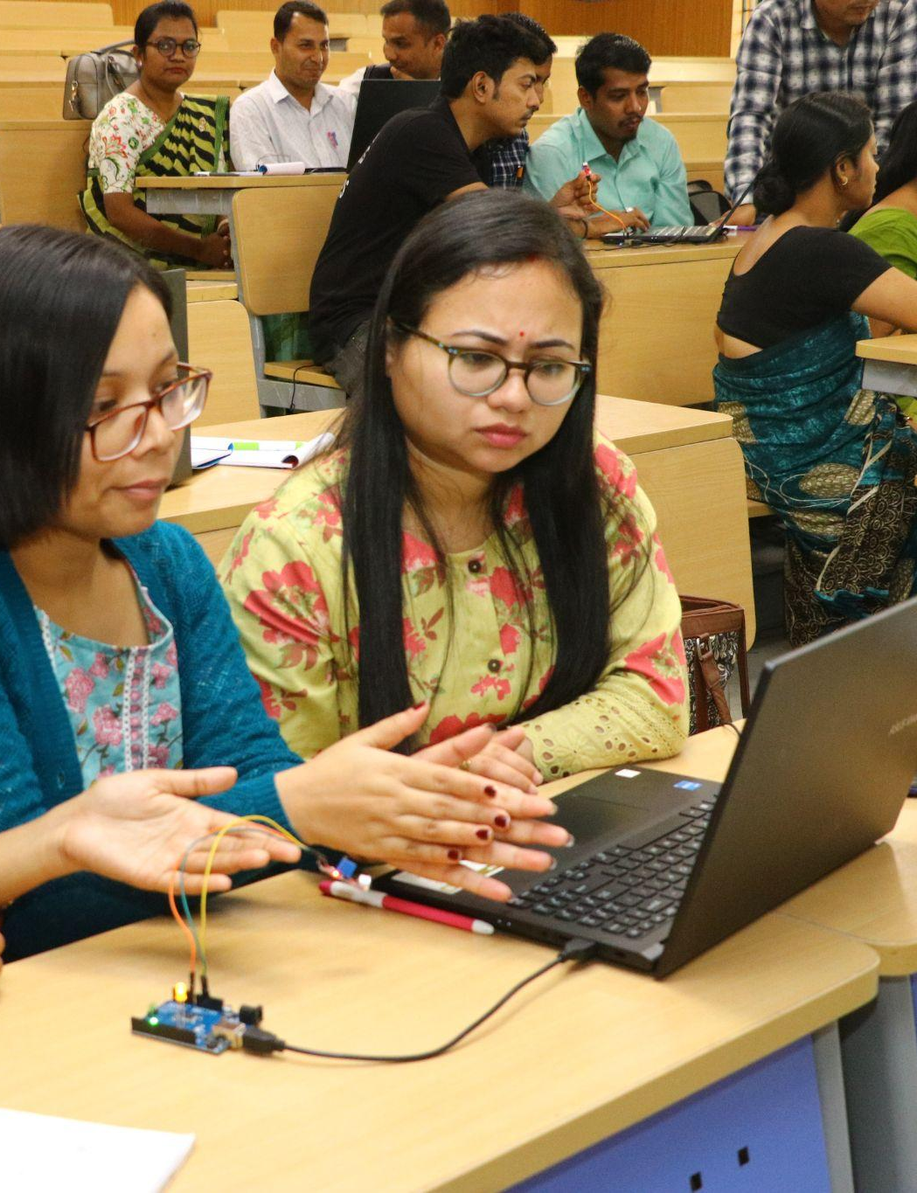
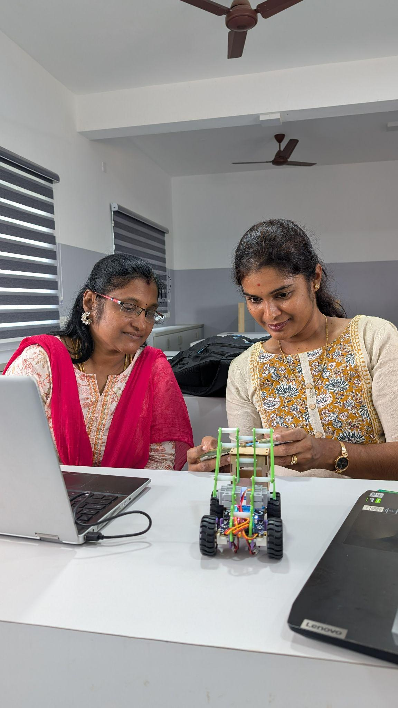


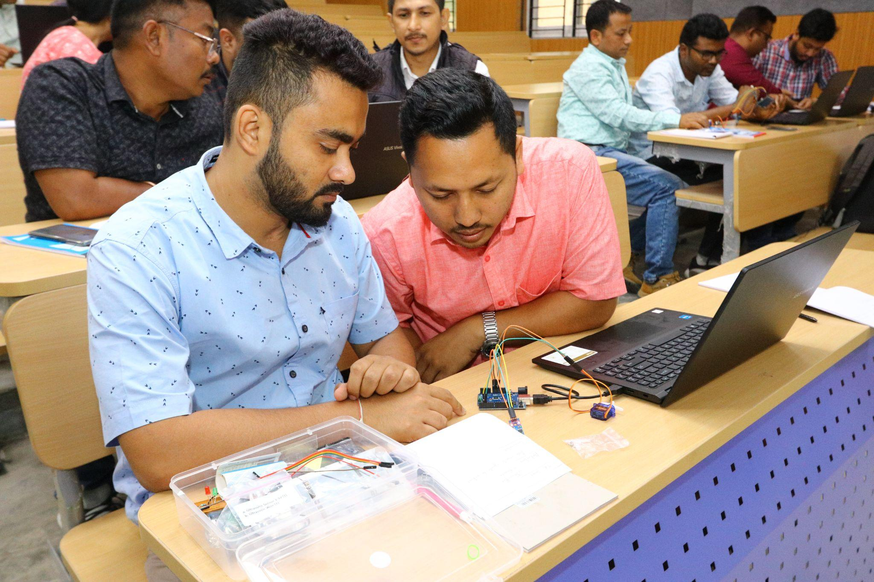
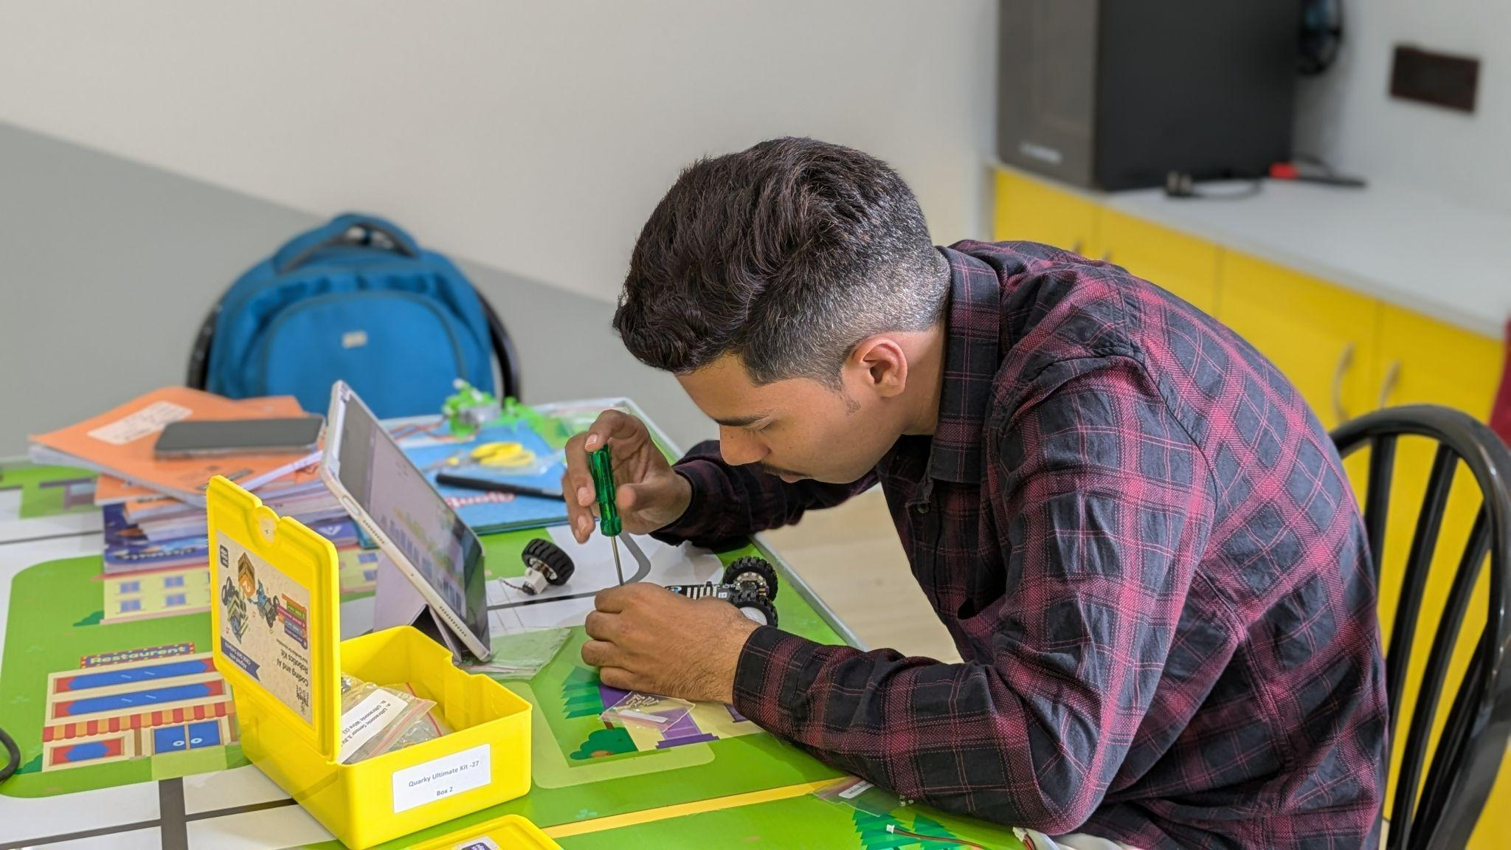
STEM & AI Educators
Upskilling Program
WEEK 1
DATE: 1st August
Presented By:
Academic Lead: Ronak Jogeshwar
Teaching Fellow: Muskan Rajak
Program Manager: Shivani Mahto

Slide 2
Schedule for Session
Session start: 5 minutes
Intro: 15 minutes
1st breakout session: 10 minutes
Discussion: 5 minutes
Slide 13-14: 5 minutes
2nd breakout session: 30 minutes
Discussion: 10 minutes
Concluding: 10 minutes
2

Slide 3
CASE STUDY
Case Study: Paperfuge
VIDEO:
https://youtu.be/pPePaKnYh2I?si=NnlvnA9xG52y7-8f
Problem: Conventional laboratory centrifuges are expensive, bulky, and require electricity, making disease diagnosis difficult in remote and low-resource settings.
Methodology: Researchers at Stanford studied an ancient whirligig toy and applied its spinning mechanism to create a lightweight, hand-powered paper centrifuge costing about $0.20.
Solution: The Paperfuge rapidly separates blood components without electricity, enabling field diagnosis of diseases such as malaria and anemia. It is portable, inexpensive, and easy to use.
Output: The innovation performs similarly to laboratory centrifuges for many diagnostic tasks while dramatically reducing cost and increasing healthcare accessibility in underserved regions. It has become a leading example of frugal innovation and human-centered design.
2

Slide 4
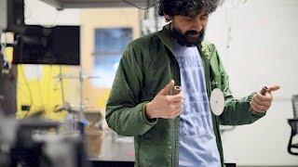

Slide 5
Design Thinking In Action
Design Thinking is best understood by doing.
OBJECTIVE
Apply the Design Thinking process to a real classroom challenge.
Collaborate with peers to generate innovative solutions.
Explore AI tools independently.
Build a classroom-ready ideation activity.
3

Slide 6
Studio Norms
During Today's Studio
Be curious, not critical.
Focus on understanding the problem before solving it.
Encourage every team member to contribute.
Build on each other's ideas.
There are only better iterations, no perfect solutions.
4

Slide 7





EMPATHIZE
Recap: The Design Thinking Process
A human-centered, iterative approach to solving complex problems.
EMPATHIZE
DEFINE
IDEATE
PROTOTYPE
TESTING
Understanding
learners
Frame the right problem
Generate multiple ideas
Build a simple solution
Gather feedback and improve
5

Slide 8
Design Thinking Exercise
VIDEO:
https://youtu.be/wZCIDpt3nBU
WHILE WATCHING
Observe
What is the actual problem?
Who are the stakeholders?
What constraints exist?
What opportunities can you identify?
6

Slide 9
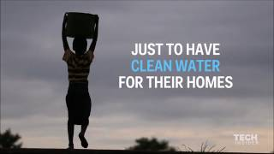

Slide 10
Breakout Room
Activity Duration: 10 Minutes
7

Slide 11
Discussion
Activity Duration: 5 Minutes
8

Slide 12
CASE STUDY
Case Study: Hippo Water Roller
VIDEO:
https://www.youtube.com/watch?v=sgWWXSEw0Dc
Problem: People in rural communities spend hours carrying heavy water containers over long distances. This limits time for education, work, and other daily activities.
Methodology: The Hippo Water Roller is a large rolling drum that transports water by being pushed or pulled. Its durable design allows users to carry much larger quantities with less physical effort.
Solution: The device makes water collection faster, easier, and less physically demanding. It reduces the burden on women and children, who are often responsible for fetching water.
Output: Communities save time and energy while gaining better access to clean water. The innovation improves quality of life and supports health, education, and economic productivity.
15

Slide 13
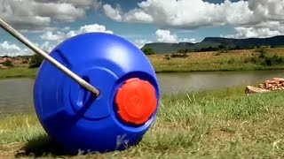

Slide 14
BREAKOUT PROMPT
Design Thinking Canvas
Complete the following
Empathize
Who is facing the problem?
Define
What is the real challenge?
Ideate
Generate at least 2 ideas.
Prototype
Select one solution.
Test
How would you evaluate the success?
14

Slide 15
BREAKOUT PROMPT 1
How can you identify student problems that AI can help solve?
10

Slide 16
BREAKOUT PROMPT 2
What are some common challenges teachers face that students could solve using AI?
11

Slide 17
BREAKOUT PROMPT 3
Imagine you are creating an AI curriculum. Where would you begin, and why?
12

Slide 18
BREAKOUT PROMPT 4
How can AI help collect challenges and ideas from school leaders, such as the principal, management, and administrators?
13

Slide 19
BREAKOUT PROMPT 5
Who else in the school community should we ask about their challenges? How can AI help solve their problems?
13

Slide 20
Discussion
Activity Duration: 10 Minutes
6

Slide 21
MATERIAL
Learning Resources
The learning doesn't stop when the session ends—these resources will help you keep building your skills.
Short Videos
Lifesaving Scientific Tools Made of Paper
Foldscope: The Paper Microscope
33

Slide 22





SELF-EXPLORATION
AI Self-Exploration
Explore any AI tool independently
GEMINI
CHATGPT
CLAUDE
COPILOT
PERPLEXITY
Empathy begins with curiosity—observe carefully, listen actively, and understand deeply before designing solutions.
16

Slide 23
GUIDELINES
Assignment Submission
Please follow these guidelines while submitting your assignments:
Submit by Wednesday, 11:59 PM (IST), unless notified otherwise.
Upload your assignment slides after the Assignment template in corresponding lecture slides shared with you, following the prescribed format.
Ensure submissions are complete, clearly named, and on time.
Include your Name, Roll No., Elective, and team details (as applicable).
Clearly define your Theme/Problem Statement.
Keep a personal backup of all submitted files.
Report any technical issues before the submission deadline.
25

Slide 24
Assignment 2a Template
REFLECTION
What problem I want to solve for : Identify a classroom problem, frame it as a student-centered design challenge
Add your answer here…
27

Slide 25
Assignment 2b Template
REFLECTION
Prepare a short ideation plan in 1 slide using AI tools.
Add your answer here…
28

Slide 26
CASE STUDY
JUMP PUMP
VIDEO:
https://www.youtube.com/watch?v=Yv6OQ3veu48
Problem: Children in rural schools often do not wash their hands because traditional hand pumps are heavy and difficult to operate. Poor hand hygiene increases the spread of diseases such as diarrhea.
Methodology: Designers observed that children enjoy jumping and playing. They redesigned the traditional hand pump into a foot-operated Jump Pump that uses children's jumping motion to draw water.
Solution: The Jump Pump makes hand-washing fun, easy, and accessible for children. It encourages regular hand-washing before meals without requiring excessive physical effort.
Output: More children wash their hands with soap, improving hygiene and reducing the risk of waterborne diseases. The innovation demonstrates how human-centered design can transform everyday challenges into engaging solutions.
7

Slide 27


