Slide 1
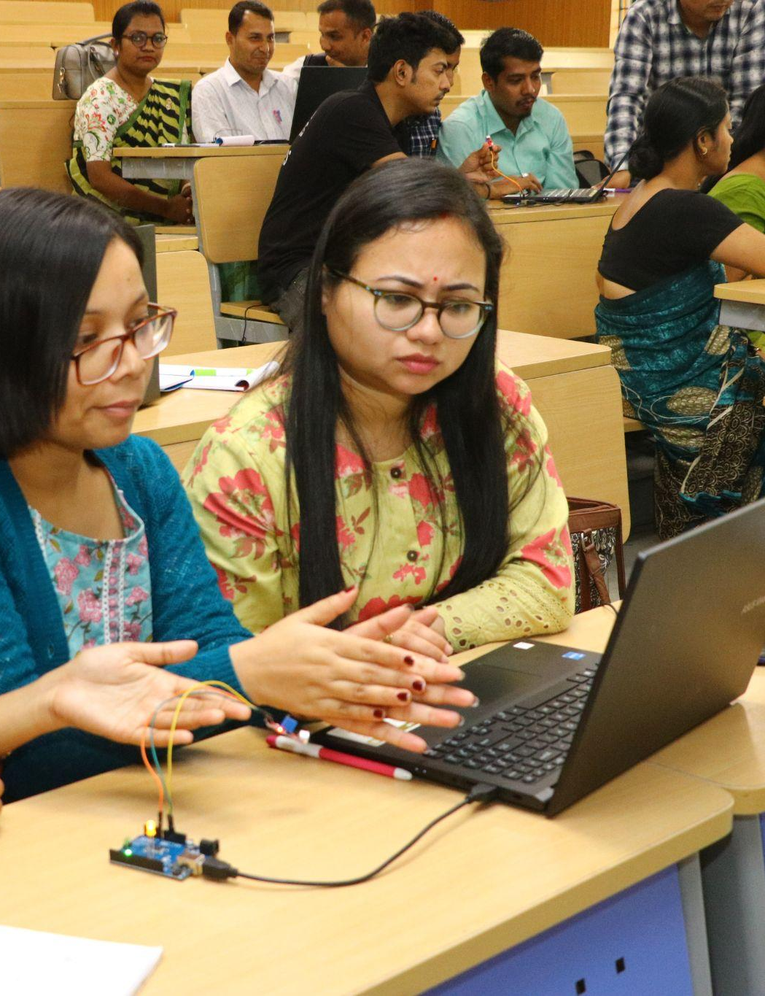
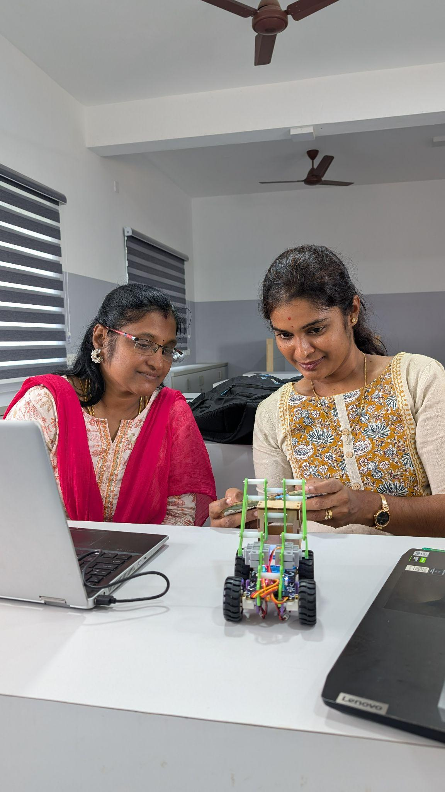


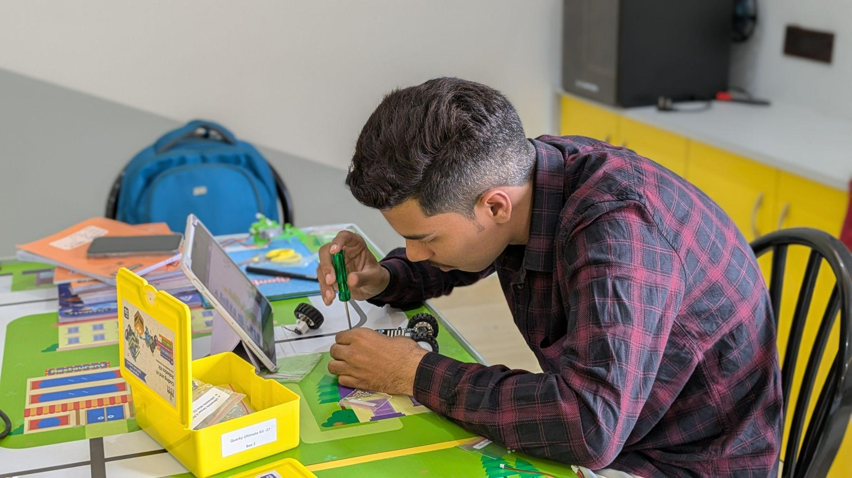
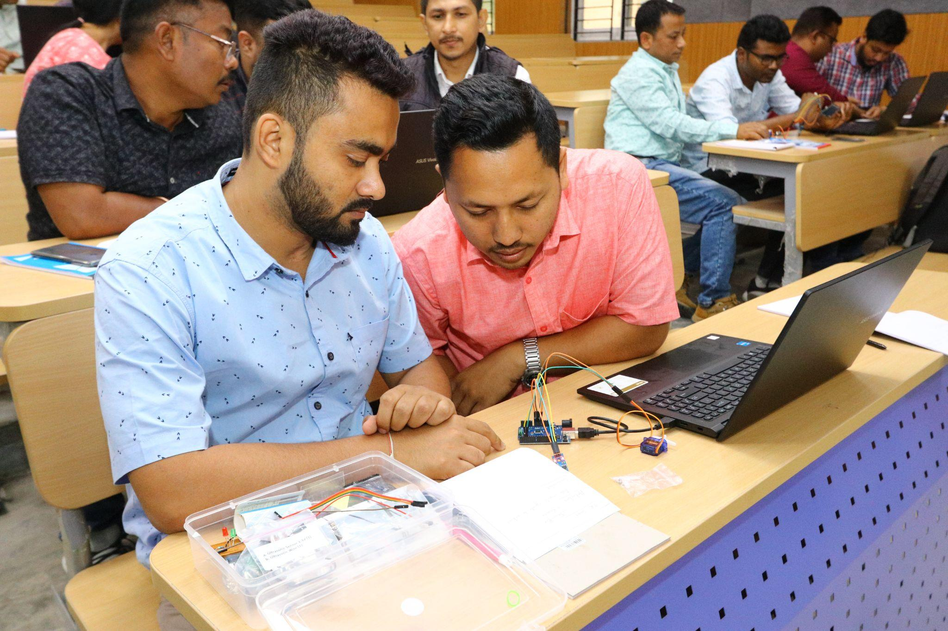
STEM & AI Educators
Upskilling Program
WEEK 3
DATE: 13th August
Presented By:
Academic Lead: Ronak Jogeshwar
Guest Speaker: Aditya Ajit Gupte
Teaching Fellow: Muskan Rajak
Program Manager: Shivani Mahto
Notes:
0:00 | Welcome. Keep this short. One line: 'In the next hour I am going to show you, live, work that used to take an hour getting done in under two minutes — and exactly which parts you must still check yourself.' Then a quick show of hands: who has used an AI tool at least once? Who uses one most weeks? This tells you how much to explain later. Do not read the slide.

Slide 2
What Have You Learned So Far?
Take a moment to think back to our previous sessions.
Let’s Hear From You!
Notes:
0:00 | Welcome. Keep this short. One line: 'In the next hour I am going to show you, live, work that used to take an hour getting done in under two minutes — and exactly which parts you must still check yourself.' Then a quick show of hands: who has used an AI tool at least once? Who uses one most weeks? This tells you how much to explain later. Do not read the slide.

Slide 3
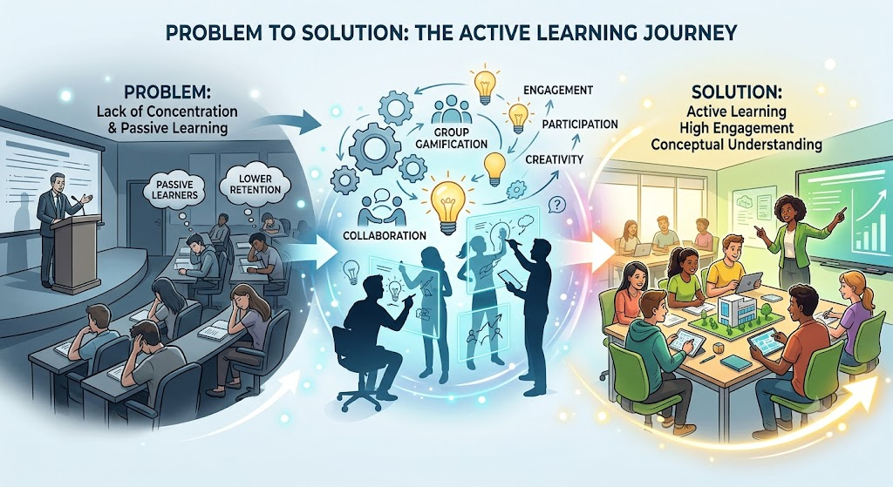
ASSIGNMENTS TILL FAR
AI Tool :Gemini
Prompt: Generate a animated image for problem statement to ideation and solution for above problem
Outcome:
by Dinesh Khatri

Slide 4
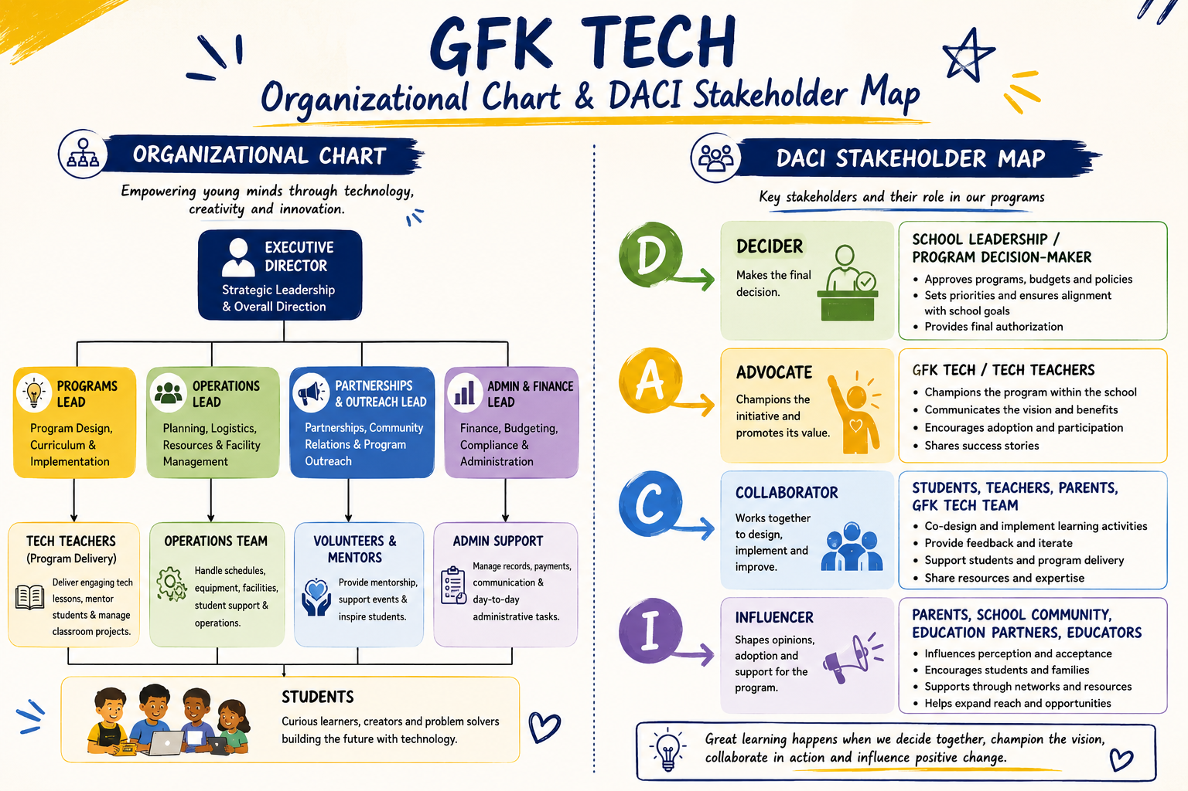
ASSIGNMENTS TILL FAR
by Eniola Ogunmola

Slide 5

Insights by:
Aditya
Gupte
Associate Professor
@DY Patil University, India
Master’s Candidate @Harvard GSE

Slide 6
THE ONE IDEA FOR TODAY
AI drafts.
You decide.
Everything else in this hour follows from that sentence.
2
Notes:
0:01-0:03 | The spine of the whole session — deliver it slowly, then expand verbally:
• AI is fast, tireless and never bored. It will write thirty report comments at 11pm on a Sunday without complaining.
• AI is also confidently wrong. It invents facts, gets arithmetic wrong, and has no idea that one child in your class lost a parent last month.
• So the job changes rather than disappears. Your expertise moves from PRODUCING material to JUDGING material.
The failure mode in schools is not that AI is dangerous. It is that people either refuse to touch it or trust it blindly. Both are wrong.
Close with the rule: never send, submit or grade anything an AI wrote that you have not read yourself.

Slide 7





OUR HOUR TOGETHER
Five things, and a lot of conversation
Where time goes
What works
What an agent is
Six live demos
Doing it safely
Stop me whenever. The demos are the part worth staying awake for.
3
Notes:
0:03-0:04 | Twenty seconds. Do not read the five boxes — they are on screen. Say only: there are four moments where I stop and ask you to talk to each other, and the middle section is live demonstrations rather than slides. Tell them nothing today requires them to have any technology in their own classroom.

Slide 8
TALK TO EACH OTHER
Which part of your week
does not feel like teaching?
Turn to the person beside you.
2 minutes
4
Notes:
0:04-0:07 | The opening interaction. Purpose: they name the problem themselves, so everything after this is an answer to THEIR question rather than your pitch.
Run it: 2 minutes in pairs, then take four or five answers out loud and write them on a board or flipchart if you have one. Whatever they say, keep the list visible — you will point back at it during the demos.
Expect: marking, reports and paperwork, parent communication, planning, cover arrangements. If somebody says 'meetings', laugh and agree, and note that AI cannot help with that one.
If the room is quiet or very large, switch to hands: 'hands up if it is marking… if it is paperwork…'.

Slide 9






THE PROBLEM
Six jobs that are not teaching
Planning
Marking
Reports
Parents
Assessment
Cover
5
Notes:
0:07-0:08 | Tie this straight back to what they just said in pairs — 'you named four of these six yourselves'. Sixty seconds maximum.
Detail if you need it:
• Planning — rewriting last year's plan, hunting for a worksheet that matches, making three versions for three ability levels.
• Marking — the single biggest block. Thirty scripts, the same six mistakes, the same comment typed thirty times.
• Reports — term comments, support plans, observation notes, portfolios.
• Parents — the same five questions, absence follow-ups, translation.
• Assessment — papers, answer keys, rubrics, and then the re-test version.
• Cover — the chart you build when three colleagues are away.
Promise: there is a demonstration later for every one of these six.

Slide 10
WHAT IS ALREADY MEASURED
This is not speculation
6 in 10
5.9 hrs
6 weeks
teachers have used AI
saved each week by weekly users
of time back across a school year
Self-reported, by teachers who chose to use it. Real, but not automatic.
6
Next Gen Insights Hub. (2025). Six Weeks A Year: How AI gives Teachers Time Back. Next Gen Insights Hub.
Notes:
0:08-0:10 | Source: Gallup with the Walton Family Foundation, June 2025, 2,232 US public school teachers, surveyed March-April 2025.
Say the caveat out loud — it is what separates training from a sales pitch, and the sceptics will trust everything you say afterwards:
• 5.9 hours is for teachers who use AI WEEKLY, not occasionally.
• It is self-reported, and mostly US and UK samples.
• Expect one to two hours in your own first month, more as your prompt library grows.
If asked what teachers do with the time: more one-to-one help for children who are behind, better-designed lessons rather than merely finished ones, and going home on time.

Slide 11








FOR TEACHERS
What it is genuinely good at
Lesson plans
Three ability levels
Papers & rubrics
Report comments
Parent messages
Translation
Explaining it differently
Spotting common errors
Learning a new topic
7
Notes:
0:10-0:12 | Do NOT read nine boxes. Choose three and describe them properly:
1. Three ability levels — the thing teachers most want and least have time for. One worksheet becomes support, core and stretch in about ninety seconds.
2. Spotting common errors — genuinely non-obvious. Give it a class set and ask what the class got wrong, not who got it wrong. That changes Monday's lesson.
3. Learning a new topic — every school has someone teaching outside their training. This is the kindest use of AI in the building, and nobody has to know.
Say: every one of these is one well-written request away, and I will show you the exact wording later.

Slide 12




FOR STUDENTS
A tutor that never gets tired
Explain it to me
another way
Give me practice
questions
Tell me what is weak
in my draft
Help me plan
my revision
Before you answer, to understand. After you answer, to check. Never instead of answering.
8
Notes:
0:12-0:14 | The most important slide for any students in the room, and for teachers deciding what to permit.
The framing that works with teenagers is not 'cheating is wrong'. It is: you are trading a good feeling now for a worse grade later, and the AI is only right about half the time anyway. You will show them the evidence for that in three slides.
Read the bottom line out loud twice. It is the whole student policy in one sentence.
Good examples to give verbally: 'I read the chapter and still do not understand it — explain it like I am twelve.' 'Give me ten questions, hardest last, and do not tell me the answers until I have tried.' 'Here is my essay — do not rewrite it, tell me the three weakest sentences and why.'

Slide 13
TALK TO EACH OTHER
Learning, or shortcut?
Four situations. Vote with your hands on each one.
3 minutes
9
Notes:
0:14-0:17 | Read each situation and ask for a show of hands: learning, or shortcut? Do not give your own verdict first.
1. A student asks AI to explain a concept they did not understand in class. (Almost everyone: learning.)
2. A student asks AI for ten extra practice questions and does them. (Learning.)
3. A student writes an essay, then asks AI which three sentences are weakest. (Most say learning — a good place to note this is the highest-value use of all.)
4. A student asks AI to write the introduction, then edits it. (The room will split. This is the useful argument — let it run for a minute.)
Land it: the disagreement in this room is exactly why a blanket 'no AI' rule fails. The answer is not a ban, it is being specific about which level of help is allowed on which task. You come back to that near the end.

Slide 14



AROUND THE WORLD
Three places that measured it
Nigeria
United Kingdom
Estonia
2 years
3.5 hrs
20,000
of normal schooling gained, in six weeks
a week saved on planning
students, with teachers trained first
10
Notes:
0:17-0:19 | Thirty seconds each, then go deeper on Nigeria next.
Nigeria — World Bank randomised trial, 800 secondary students in nine public schools in Benin City, six weeks of after-school English with an AI tutor and a teacher present. Gains equal to 1.5-2 years of ordinary schooling; among the most cost-effective education interventions ever measured.
United Kingdom — Oak National Academy, the government-backed curriculum body, built a free lesson assistant grounded in vetted curriculum resources rather than the open internet. Teachers report about 3.5 hours a week saved on planning, with a range from 1 to 15.
Estonia — the national 'AI Leap' programme, from September 2025: free access plus structured training for every student in grades 10-11 and their teachers. 20,000 students, 3,000 teachers in year one. Teachers were trained a full term BEFORE students got access.
The transferable lesson across all three: train the adults first.

Slide 15



NIGERIA · WORLD BANK TRIAL
Six weeks. Two years of learning.
Why it worked
800
A teacher was in the room
students, nine public schools,
six weeks of after-school English
The task was narrow
It was extra, not a replacement
Not students left alone with a chatbot.
11
Notes:
0:19-0:21 | The three reasons on the left are the transferable part — the headline number is only the hook.
1. A teacher was in the room. The teacher set the task, kept the pace, and handled the moments the AI got wrong.
2. The task was narrow and structured — specific grammar and writing objectives, not 'go and learn English'.
3. It was extra, not a substitute. After-school time added to normal teaching. Nobody's lessons were replaced.
One honest nuance worth saying: the largest gains were for girls and for students already doing reasonably well. AI tutoring does not automatically close gaps — you have to design for the children at the bottom deliberately.
Source: World Bank, 'From Chalkboards to Chatbots', 2025.

Slide 16

AND THE ONE THAT FAILED
17% worse
Students given an unrestricted AI assistant solved far more practice
problems — then scored below classmates who never had it.
The fix: the same AI, told to give hints and refuse answers. The damage disappeared.
Lasherica Thorton. (2024). Students using artificial intelligence did worse on tests, experiment shows. EdSource.
12
Notes:
0:21-0:24 | The slide teachers will quote back to you for months. Do not rush it.
The study: Bastani and colleagues, published in PNAS in 2025. Around 1,000 high-school students across roughly 50 classrooms in Türkiye, learning mathematics. Three groups:
• Textbook only — the baseline.
• Unrestricted AI chatbot — solved 48% more practice problems while they had it, then scored 17% BELOW the baseline group in an exam without it.
• A guarded tutor — same model, instructed to give hints, refuse direct answers and check understanding. The practice gains stayed and the exam penalty largely disappeared.
What actually happened: almost all of the middle group simply asked for the final answer. The model gave one — and was correct only about half the time. Students copied the flawed answers without noticing. They felt they were learning because the worksheet was finished.
The sentence to land: same model, same students, same topic — the only difference was the instructions, and that difference was the entire result.
This also disarms the sceptics: you are agreeing with their concern and handing them the fix.

Slide 17



CONTEXT CHANGES THE ARGUMENT
The same tool means different things
A well-resourced school
A class of sixty, four grades, one teacher
Where home, school and exam languages differ
AI saves a teacher an hour.
Three levels of worksheet were never possible at all.
One worksheet, produced in both.
Kerala trained 80,000 teachers before students were given access. So did Estonia. Adults first.
Express News Service. (2024). Kerala to train 80,000 secondary teachers in Al. The New Indian Express
13
Notes:
0:24-0:26 | Keep this global — the point is that context, not the tool, decides the value.
The middle column is the important one. In a well-resourced school AI makes a possible thing cheaper. In a classroom with sixty children across four grades and one teacher, differentiated material was never possible at all — so this is not a convenience, it is a capability that did not previously exist. That applies equally in rural India, in much of sub-Saharan Africa, in remote schools anywhere.
Language: in a very large share of the world's classrooms the child's home language, the language of instruction and the language of the exam are three different things. Producing the same worksheet twice is, for many teachers, the single most valuable thing here.
Kerala, India: the state education technology body KITE put 80,000 secondary teachers through hands-on AI workshops in 2024, then extended it to primary teachers — and taught deepfakes, privacy and bias in the same sessions as the productivity uses. Estonia reached the same conclusion independently. If your school takes one idea from this hour, take that one.
Caveats worth stating: AI translation is much stronger in some languages than others — always have a fluent speaker check anything going home to families.

Slide 18
TALK TO EACH OTHER
Which job would you
hand over first?
Pick one. Say why to your neighbour.
2 minutes
14
Notes:
0:26-0:28 | Short and personal. They pick ONE job from the six you showed earlier — planning, marking, reports, parents, assessment, cover.
Take three or four answers aloud, then say: 'whichever you chose, you are about to watch it happen.' Then move straight into the agent section. This is your bridge into the demos and it makes the room feel the demos were chosen for them.
If someone picks something you are not demonstrating, promise to show them afterwards — and mean it.

Slide 19


THE ONLY NEW WORD TODAY
Asking, versus handing over
A chatbot
An agent
You ask a question.
You get words back.
You do the rest.
You give it a job and your files.
It does the steps.
You check the finished work.
Like the difference between asking a colleague a question in the corridor, and giving a task to a capable new teacher.
15
Notes:
0:28-0:30 | The corridor-versus-colleague analogy is the anchor. Use it again during every demo.
The honest framing: an agent is not cleverer than the chatbot. It just has hands. Same brain, more reach.
And exactly like a capable new colleague, the quality of what comes back depends almost entirely on how clearly you briefed them — which is why the wording matters, and why you will show them the wording.
Nobody in the room needs to build anything. The agents you will demonstrate are ordinary AI tools with a file attached.

Slide 20





WHAT ACTUALLY HAPPENS
Five steps. Two of them stay yours.
›
›
›
›
You set the job
It plans
It works
It checks itself
You approve
Steps 1 and 5 take you four minutes. Steps 2 to 4 used to take ninety.
16
Notes:
0:30-0:32 | Walk the five boxes with a finger on the screen. The two shaded ones are yours and always will be.
Step 5 is not optional. An agent that sends messages to parents without a human reading them is not a time-saver, it is an incident waiting to happen. Every agent you are about to see stops and asks before anything leaves the building.
The bottom line is where the value comes from — say it, then go straight to the demos.

Slide 21

BEFORE WE START
Nothing you are about to see
is a real child.
A fictional school. Invented names, marks and messages.
This is also how you should practise: fake data first, always.
17
Notes:
0:32-0:33 | Say this sentence out loud, deliberately. If your school has anyone responsible for data protection, this is the sentence they need to hear you say.
The teaching point underneath it: you can practise, demonstrate and build every one of these workflows without a single real student record leaving your school. Build on fake data first; swap in real files only once the workflow is proven and your school has approved it.
Set up the class: Class 8B, thirty students, one maths teacher, and the ordinary files any school has — a marks sheet, a parent inbox, a staff timetable, a set of student answers.

Slide 22
DEMONSTRATION 1 OF 6
Who is slipping, and why
THE JOB
WHAT COMES BACK
A marks sheet.
Thirty names.
Four test scores each.
Fourteen children flagged
Sorted by cause, not by score
One who fell. One who never had it. One who stopped coming.
A different action for each
›
45 min → 4 min
You still read every word before it counts.
18
Notes:
0:33-0:36 | Run it live. Narrate against the five steps: I set the job, it plans, it works, it checks itself, I approve.
The moment that lands with teachers is the grouping — by CAUSE, not by score. Any spreadsheet sorts by marks. The useful move is separating 'was fine and fell' from 'has never been fine', because those two children need completely different responses and a sorted list hides that.
On the fictional class it finds fourteen flagged children: four whose decline tracks their attendance, two who fell while attending every lesson, and eight who have been in the same low band all year and are not declining at all.
Then do the honest bit: pick two rows and check the averages on a calculator on screen. Showing that you verify is more valuable than showing that it works.

Slide 23

DEMONSTRATION 2 OF 6
A lesson at three levels
THE JOB
WHAT COMES BACK
One objective.
Forty minutes.
Mixed ability.
A plan with timings
The three mistakes to expect
Practice at three levels, with answers
An exit ticket that tells you who is lost
›
90 min → 6 min
You still read every word before it counts.
19
Notes:
0:36-0:39 | The three levels are the headline — the thing teachers most want and least have time for.
But pause on the second item: asking it, in advance, for the common student errors. That is the difference between a lesson plan and a teacher's lesson plan, and it comes from one extra sentence in the request.
Point out that the exit ticket questions each target one of those three errors — so the answers tell you WHICH misconception to reteach, not merely who got it wrong.
Show the wording briefly. The context at the top — forty minutes, mixed ability, blackboard, second-language learners — is doing most of the work. Same request without that context produces something unusable.

Slide 24

DEMONSTRATION 3 OF 6
An inbox before assembly
THE JOB
WHAT COMES BACK
Forty messages
from parents,
over one weekend.
Sorted: urgent, routine, no reply needed
Five held back and NOT answered
An injury, a bereavement, a bullying report
Replies drafted in the language each parent wrote in
›
60 min → 8 min
You still read every word before it counts.
20
Notes:
0:39-0:42 | The most important thing here is what it REFUSES to do.
Five messages are held back and deliberately not drafted: a possible injury during games, a bereavement at home, a bullying report, a child kept after school without the parents knowing, and an undisclosed food allergy. Each is flagged with a reason.
Say it plainly: safeguarding, health and allegations never get an AI-drafted reply. Ever. That rule belongs in your school's written policy, not only in a request you happen to type well that morning.
An agent that knows what NOT to write is worth more than one that writes everything.
Also show the multilingual drafting — replies going back in the language the parent actually wrote in. For a great many schools this alone justifies the whole workflow, because it reaches families who would otherwise never receive a written reply they can read comfortably.

Slide 25
DEMONSTRATION 4 OF 6
Three teachers are away
THE JOB
WHAT COMES BACK
A timetable.
Three absences.
Fourteen lessons
with nobody in front.
Twelve of fourteen covered
Nobody double-booked, nobody overloaded
Two periods it could NOT solve
And it says so, instead of inventing
›
40 min → 3 min
You still read every word before it counts.
21
Notes:
0:42-0:44 | The moment to highlight is the failure report.
A weak agent invents a teacher who does not exist, or double-books someone. A well-briefed one says: 'I could not solve these two periods — here are your options.' On this data it covers twelve of fourteen and refuses the other two.
The instruction that produces that behaviour is one sentence: 'list anything you could not solve rather than inventing a solution.' Tell people to put that line in any request where a wrong answer is worse than no answer. It is one of the most valuable sentences in the session.
One more thing to point at: it was told to keep one teacher free in period five. That teacher was available AND was the ideal subject specialist — and it still left her alone. It followed the constraint over the optimisation. Verify it on screen.

Slide 26

DEMONSTRATION 5 OF 6
The tutor that says no
THE JOB
WHAT COMES BACK
A student asks:
"Just tell me
the answer."
It refuses
It asks one question back
It waits
It makes them explain why it works
›
the shortcut → the learning
You still read every word before it counts.
22
Notes:
0:44-0:46 | Give this one to the students in the room, and run it live.
Try to break it. Ask for the answer, then insist, then claim you already solved it and only want to check, then say your teacher allowed it. Let the room watch it hold the line four times. That is far more persuasive than any policy document.
Connect it explicitly to the failed study earlier: this is the guarded version — the one where the exam damage disappeared. The tool did not change. The instructions did.
Tell teachers they can make this the class standard: if you use AI for homework, use this wording, and be ready to show me the conversation. Asking to see the conversation rather than the answer changes the whole dynamic.

Slide 27

DEMONSTRATION 6 OF 6
Thirty scripts, one evening
THE JOB
WHAT COMES BACK
Thirty answers
to the same
word problem.
Every response given a level and one line of feedback
Seven flagged: “unsure, check me”
The three mistakes the class shares
You moderate all of it
›
3 hrs → 35 min
You still read every word before it counts.
23
Notes:
0:46-0:47 | Be careful and honest here, because this is the demonstration that makes people nervous.
Say it plainly: this does not mark the papers. It does a first pass, and you moderate all of it.
The real prize is the aggregate. Knowing that a large group of the class cannot turn a sentence into an equation tells you what to teach on Monday — and no teacher has time to derive that by hand from thirty scripts at nine at night.
Point at the flagged responses: several children reached the right answer by an unusual route, and the agent said it was unsure rather than marking them down. An agent that admits uncertainty is far safer than one that does not. Those are the scripts you look at first.

Slide 28
ADDING IT UP
One week of the same six jobs
8 hrs → 1 hr
in a single week, on this
fictional class
Your first week will be slower, not faster. You are learning to brief.
24
Notes:
0:47-0:49 | Do not oversell this. The box on the lower right is what makes it believable — say it out loud.
Three honest footnotes:
• Week one is an investment, not a saving. If a teacher tries this on Tuesday and it takes longer, they will never try again unless you warned them.
• The 'with an agent' figures include checking time. They are not raw speed.
• The value is in reuse — the same six requests, every week, for thirty weeks. Not in one clever trick.
Timings are illustrative and measured on this fictional class. Say so.

Slide 29


DOING IT SAFELY
Three rules. That is the whole policy.
Never put a real child's name, marks or circumstances into it
Roll numbers work just as well.
Check anything it counts, quotes or cites
The more fluent it sounds, the harder you check.
Say which level of help is allowed on each task
A ban is unenforceable. A rule is not.
If you would not read it aloud with the parents in the room, do not type it in.
25
Notes:
0:49-0:52 | Three rules, and the one-line test at the bottom is the takeaway.
Rule 1 — never a real child's name together with marks, behaviour, health, family circumstances or anything from a safeguarding conversation. Also no addresses, ID numbers, photographs, or exam papers before the exam. Point back at the marks demonstration: replacing names with roll numbers would have changed nothing about the result. That single habit removes most of the risk. Use your school's account rather than a personal free one where you can, and check whether your settings allow your data to be used for training.
Rule 2 — verify anything it counts, quotes or cites. It will invent a page number, a source, a statistic, and sound completely confident doing it. If you have internet and a spare thirty seconds, ask it for a specific page reference in a textbook you know and watch it invent one. Nothing you say about this lands as hard as watching it happen.
Rule 3 — leads into the next slide.

Slide 30
FOR STUDENT WORK
Print the level on the task sheet
LEVEL 0
LEVEL 1
LEVEL 2
LEVEL 3
No AI
Planning only
Coach my draft
Work together
Done in the room, on paper.
Ideas and structure. Your words.
It comments. It does not write.
Declare it. Defend it out loud.
Now the conversation is about following an instruction, not about catching anyone.
26
Notes:
0:52-0:54 | The slide school leaders should photograph.
Two things to say clearly:
• AI-detection software is not reliable enough to accuse a child with, and a false accusation does lasting damage. Design the task instead of policing the tool.
• Level 0 does not disappear. Some things must still be done unaided, in a room, on paper — and that is exactly what the failed study argues for.
Practical: write 'This task is Level 1' on the assignment sheet. Teenagers can respect a rule they can see. They cannot respect a vague ban that half the staff ignore.
Come back to the earlier vote: the room disagreed about the essay-introduction case. This scale is how you settle that disagreement in advance instead of afterwards.

Slide 31
TALK TO EACH OTHER
What would your school
need to decide?
Three ideas from the room.
3 minutes
27
Notes:
0:54-0:57 | The closing interaction, and the one that produces action rather than enthusiasm.
Take three or four answers and write them down where everyone can see. Steer gently towards the six that actually matter, and note that only one of them costs money:
1. Which tools staff may use, on a school account.
2. A one-page data rule — what may never be uploaded, and who to ask when unsure.
3. Adopt the levels 0-3 scale and print it on task sheets.
4. Timetabled training time. Estonia and Kerala both trained teachers before students. This is the one that costs something, and the one that decides whether any of this survives.
5. One named person to ask — ideally a respected classroom teacher, not the IT lead.
6. Review after one term: what did we save, what went wrong, what do we stop.
If leaders are present, address them directly. Points 1, 2 and 3 can be signed off in a single meeting.

Slide 32



MONDAY MORNING
Four weeks, one habit at a time
WEEK 1
WEEK 2
WEEK 3
WEEK 4
Pick one job you hate
Save the wording that worked
Try it on a real file
Give the tutor rule to students
One job. Three tries. Then the next one.
28
Notes:
0:57-0:59 | Ask everyone to commit out loud, or on a slip of paper, to the single task they are taking into week one. Public commitment roughly doubles follow-through.
Week 1 — one recurring task only. Do it with AI three times, side by side with your usual method, so you can judge honestly.
Week 2 — save the wording that worked in a notes file and reuse it on a different topic. This is the week the time saving actually appears.
Week 3 — move from asking to handing over: attach an anonymised file and give it a multi-step job.
Week 4 — introduce the tutor rule to students and set one task with an explicit level on it.
The most common failure is trying everything in week one, getting mediocre results from all of it, and concluding AI does not work.
Offer a short follow-up clinic in three weeks — that is when people hit their first real wall, and it is the cheapest thing you can do to keep momentum.

Slide 33
AI will not replace teachers.
It gives back the hours
that were never teaching.
TEACHERS
STUDENTS
LEADERS
Pick one job. Try it three times.
Ask for hints. Never for answers.
One tool. One data rule. One scale.
Thank you · adityagupte@gse.harvard.edu
Notes:
0:59-1:00 | Close on the sentence, pause, then give the three actions and stop. Do not add new content.
If questions run long, the two people most often ask about are the levels 0-3 scale and the data rules — have those slide numbers ready.
Remind them the handout has every case study, source and prompt in full, and that the demonstration console is theirs to keep and try.

Slide 34
Discussion

Slide 35
MATERIAL
Learning Resources
The learning doesn't stop when the session ends—these resources will help you keep building your skills.
Reading
Let ChatGPT be your Teaching Assistant
Tools
AI Teaching Assistant
Video
How Al Could Save (Not Destroy)

Slide 36
Schedule Update
This week's Saturday session has been rescheduled to Friday due to India's Independence Day celebrations.
We look forward to seeing you on Friday instead!

Slide 37
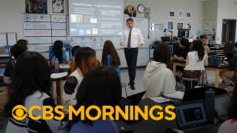
Notes:
0:00 | Welcome. Keep this short. One line: 'In the next hour I am going to show you, live, work that used to take an hour getting done in under two minutes — and exactly which parts you must still check yourself.' Then a quick show of hands: who has used an AI tool at least once? Who uses one most weeks? This tells you how much to explain later. Do not read the slide.

