Slide 1
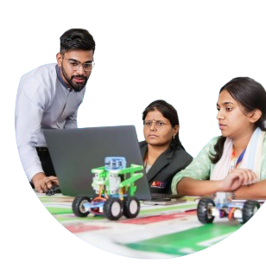
Welcome to
#AI-Native 2026
100-Day STEAM & AI Educators
Upskilling Journey
Day 1: 30th July, 2026
Presented By:
Academic Lead: Ronak Jogeshwar
Teaching Fellow: Muskan Rajak
Program Manager: Shivani Mahto

Slide 2
WHY AI NATIVE PROGRAM?
Why #AI-Native Educators Need to be Design Thinkers
Great educators don't start
with technology;
they start with people and
the problems that matter.
#AI-Native Program
01

Slide 3
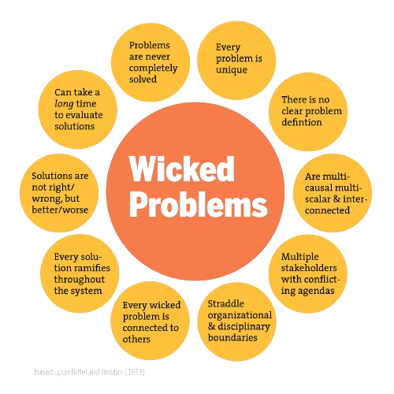
WHY AI NATIVE PROGRAM?
Wicked Problems in Design Thinking
Why are Wicked Problems Important?
Reflect real-world challenges with evolving needs.
Require understanding people, not just technology.
Encourage collaboration across diverse perspectives.
Demand experimentation and iterative improvement.
Balance innovation with ethics and sustainability.
#AI-Native Program
01

Slide 4
AI + HUMAN-CENTRED DESIGN
Design Thinking with AI: Use AI after the problem is framed
AI should expand possibilities, not replace the educator’s judgment and human cognition.
Human inquiry
Observe learners
Listen to context
Frame the challenge
AI assistance
Generate options
Create examples
Simulate variations
Educator judgment
Critique output
Localize activity
Protect learning intent
Start with people
Use AI as partner
Return to pedagogy
The question is not ‘How do I use AI?’
The better question is: ‘What learning problem deserves AI helps me solve?’

Slide 5
EMPATHIZE
Why in an #AI-Native Program
Before we explore the Design Thinking process, let's first understand the nature of the problems it is designed to solve—wicked problems.
AI is most impactful when solving meaningful problems.
KEY TAKEAWAYS
Design Thinking provides a human-centered framework to navigate complexity and build AI solutions that are innovative, practical, and impactful.
Design Thinking helps uncover the real challenge.
Human insights make AI solutions more relevant.
Continuous feedback leads to better AI outcomes.
Design Thinking begins by recognizing that today's most important challenges are rarely simple.
#AI-Native Program
04

Slide 6
CHALLENGES
Learning Outcomes
By the end of today’s session, you will:
Introduction to Design Thinking
Practical Problem-Solving Approach for Educators
Empathy in Design Thinking
Problem Definition Using Design Thinking
Ideation Process
Prototyping, Testing, and Iteration
Today is about learning to think like a designer, not just using design tools.
#AI-Native Program
02

Slide 7
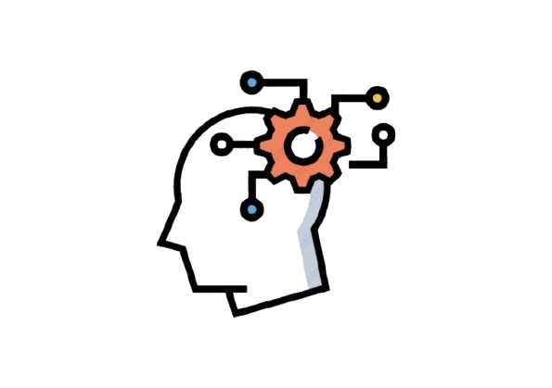



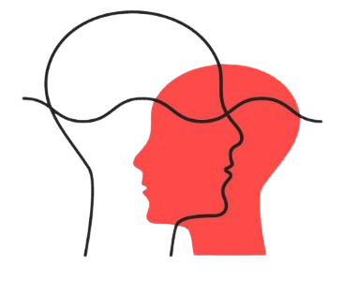
STAGES
5 Stages of Design Thinking
Design Thinking is a human-centered approach that helps us understand problems deeply before creating solutions
EMPATHIZE
DEFINE
IDEATE
PROTOTYPE
TESTING
These five stages form an iterative cycle that helps us continuously refine our ideas and improve learning experiences
#AI-Native Program
03

Slide 8
EMPATHIZE
Step 1: Empathize
Empathize means understanding learners by observing their experiences, listening to their perspectives, and engaging with their real needs before designing solutions.
KEY ACTIONS
OBSERVE
What do students do?
Design
for
learners,
not assumptions.
LISTEN
What do students say and feel?
ENGAGE
What do students need and experience?
The better we understand our learners, the better we can design meaningful learning experiences.
#AI-Native Program
04

Slide 9
EMPATHIZE
Why Empathize?
Understand learners beyond their academic performance.
KEY TAKEAWAYS
Observe how students think, behave, and interact.
The best solutions begin with understanding the learner, not the technology.
Identify learners' needs, motivations, and challenges.
Replace assumptions with real insights.
Design learning experiences that are relevant and engaging.
Create solutions that address actual learner needs.
Empathy is the foundation of meaningful learning design.
#AI-Native Program
05
#AI-Native Program

Slide 10
EMPATHIZE
How To Empathize?
To design meaningful learning experiences, we must first understand our learners through purposeful observation and conversation.
OBSERVE
LISTEN
ENGAGE
Watch how learners participate
and interact.
Listen actively without making
assumptions.
Talk to learners about their
experiences.
Notice what excites, frustrates, or disengages them.
Pay attention to both verbal and
non-verbal cues.
Ask open-ended questions like
"Why?" and "Tell me more."
Look beyond marks to understand
behaviors.
Encourage learners to express their
thoughts and feelings.
Create a safe space for honest conversations.
Empathy begins with curiosity—observe carefully, listen actively, and understand deeply before designing solutions.
#AI-Native Program
06

Slide 11
DEFINE
Step 2: Define
Once we understand our learners, the next step is to clearly define the real problem before exploring possible solutions.
Makes sense of insights gathered during empathy.
WHAT IS DEFINE?
Narrows broad observations into one clear challenge.
Once we understand our learners, the next step is to clearly define the real problem before exploring possible solutions.
Aligns the team around a common problem.
Creates focus before generating ideas.
A clear definition of the problem lays the foundation for meaningful and impactful solutions.
07
#AI-Native Program
04
#AI-Native Program

Slide 12
DEFINE
Why Define?
A solution is only as effective as the problem it is designed to solve.
Provides clarity by focusing on the most important challenge.
Prevents solving the wrong problem or addressing only the symptoms.
Aligns everyone around a shared understanding of the challenge.
Saves time and effort by directing ideas toward a clear goal.
Creates a strong foundation for meaningful and innovative solutions.
Defining the right challenge is the first step toward creating meaningful change with AI.
#AI-Native Program
05
#AI-Native Program

Slide 13
DEFINE
How To Define?
Once we've understood our learners, the next step is to organize those insights into a clear and actionable problem statement.
IDENTIFY YOUR AUDIENCE
REVEAL NEEDS
ARTICULATE INSIGHTS
Develop an understanding of the type of person you are designing for – your Audience.
Work to express INSIGHTS you developed through the information gathered through empathy and research work
Create and select a limited set of NEEDS that you think are important to fulfill
The clearer your problem statement, the more relevant and impactful your ideas will be.
#AI-Native Program
09

Slide 14
IDEATE
Step 3: Ideate
Once the problem is clearly defined, the next step is to explore possibilities without limiting creativity.
Focuses on possibilities rather than limitations.
WHAT IS IDEATE?
Encourages creative and divergent thinking.
The Ideate stage is where we generate a wide range of possible solutions to the defined problem. It encourages creative thinking and the exploration of different perspectives before selecting the most suitable approach.
Key Characteristics
Explores multiple approaches to the same challenge.
Builds on insights gathered from the previous stages.
Delays judgment until ideas have been fully explored.
Great solutions begin with the willingness to explore many ideas before choosing one.
#AI-Native Program
11

Slide 15
IDEATE
Why Ideate?
The best solutions rarely emerge from the first idea; they emerge from exploring many possibilities.
To step beyond obvious solutions
To connect the collective perspectives
To uncover unexpected areas of exploration
To create easy and flexible innovation options
The more ideas we explore, the greater our chances of discovering meaningful and innovative solutions.
#AI-Native Program
05
#AI-Native Program

Slide 16


IDEATE
How to Ideate?
Ideation is most effective when we suspend judgment, think broadly, and encourage every idea before choosing the best one.
REGULAR BRAINSTORMING
REVERSE BRAINSTORMING
Encourage every idea without criticism.
Build on others' ideas collaboratively.
Aim for quantity before quality.
Capture all ideas for later evaluation.
Ask, "How could we make this problem worse?"
Identify actions or barriers that create the problem.
Reverse those insights to discover innovative solutions.
Reveal hidden assumptions and opportunities.
Effective ideation is about exploring possibilities first and evaluating solutions later.
#AI-Native Program
05
#AI-Native Program

Slide 17
PROTOTYPING
Step 4: Prototyping
Ideas become meaningful only when we bring them to life. Prototyping is the first step toward turning concepts into reality.
Represents an idea in a simple and practical form.
What is Prototyping?
Focuses on learning rather than perfection.
The Prototype stage is the process of creating a simple, tangible representation of an idea to explore, demonstrate, and refine a possible solution.
Key Characteristics
Makes abstract ideas visible and testable.
Encourages experimentation before full implementation.
Provides a basis for gathering feedback and improvement.
A prototype transforms an idea from imagination into something that can be explored, shared, and improved.
#AI-Native Program
11

Slide 18
PROTOTYPING
Why Prototype?
The purpose of a prototype is to learn whether it works.
Validate AI-assisted ideas before full classroom implementation.
Identify strengths, gaps, and opportunities through early experimentation.
Gather meaningful feedback from learners and stakeholders.
Refine solutions based on real classroom experiences.
Build confidence through continuous iteration and improvement.
Prototype early, learn continuously, and let learner feedback shape AI-enabled educational solutions.
#AI-Native Program
05
#AI-Native Program

Slide 19




PROTOTYPING
How to Prototype?
A prototype just needs to be good enough to learn from and does not have to be perfect.
KEEP IT SIMPLE
BUILD FOR THE USER
TEST ONE IDEA AT A TIME
ITERATE QUICKLY
Build the simplest version of your idea.
Focus only on the core concept.
Design with the learner's needs in mind.
Keep the prototype relevant to the problem.
Decide what you want to validate.
Avoid testing multiple assumptions together.
Gather feedback, improve, and repeat.
Refine the prototype based on what you learn.
Build small, test early, learn continuously, and let feedback, not assumptions, shape your final solution.
#AI-Native Program
09

Slide 20
TESTING
Step 5: Testing
A solution is only effective when it works for the people it is designed to serve.
What is Testing?
Implement the learning activity with students in a real classroom.
Testing is the process of implementing AI-supported learning experiences, collecting evidence from the classroom, and refining them based on student feedback and outcomes.
Observe student engagement, participation, and learning outcomes.
Key Characteristics
Collect feedback from students and other stakeholders.
Evaluate what worked well and what needs improvement.
Refine the learning experience based on evidence and feedback.
The true measure of any learning design is how students experience it in the classroom.
#AI-Native Program
11

Slide 21
TESTING
Why Test?
Testing helps us learn what works, what doesn't, and what needs to improve.
Validate whether the solution improves learner outcomes.
Refine AI-assisted ideas using classroom feedback.
Adapt solutions to meet diverse learner needs.
Identify gaps, opportunities, and unexpected insights.
Build confidence before scaling implementation.
Every round of testing brings you closer to a more effective solution.
#AI-Native Program
05
#AI-Native Program

Slide 22
DEFINE
How to Test?
Testing helps educators understand how students experience a learning activity and what can be improved.
IMPLEMENT IN THE CLASSROOM
OBSERVE STUDENT EXPERIENCES
COLLECT MEANINGFUL FEEDBACK
REFLECT &
REFINE
Facilitate the activity with students in a real learning environment.
Use classroom evidence and AI insights to improve the learning experience.
Watch how students engage, collaborate, and respond.
Ask students what helped them learn and what could be improved.
The clearer your problem statement, the more relevant and impactful your ideas will be.
#AI-Native Program
09

Slide 23
GUIDELINES
Assignment Submission
Please follow these guidelines while submitting your assignments:
Submit by Wednesday, 11:59 PM (IST), unless notified otherwise.
Upload your assignment slides after the Assignment template in corresponding lecture slides shared with you, following the prescribed format.
Ensure submissions are complete, clearly named, and on time.
Include your Name, Roll No., Elective, and team details (as applicable).
Clearly define your Theme/Problem Statement.
Keep a personal backup of all submitted files.
Report any technical issues before the submission deadline.
#AI-Native Program
10

Slide 24
MATERIAL
Learning Resources
The learning doesn't stop when the session ends—these resources will help you keep building your skills.
Short Videos
Constructionism vs Instructionism
Learning through Projects
Engagement not Explanation
Reading
Wicked Problem in Design Thinking
#AI-Native Program
11

Slide 25
Assignment 2a Template
REFLECTION
What problem I want to solve for : Identify a classroom problem, frame it as a student-centered design challenge
Add your answer here…
#AI-Native Program
12

Slide 26
Assignment 2b Template
REFLECTION
Prepare a short ideation plan in 1 slide using AI tools.
Add your answer here…
#AI-Native Program
12

Slide 27
THANK YOU!

