Slide 1
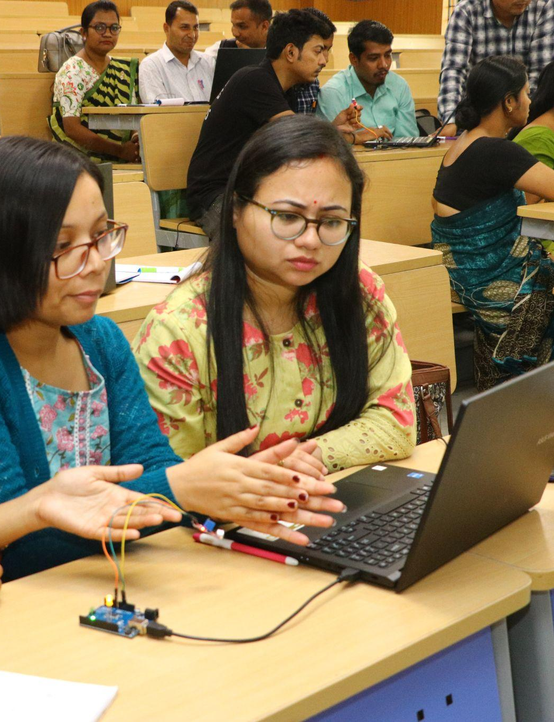
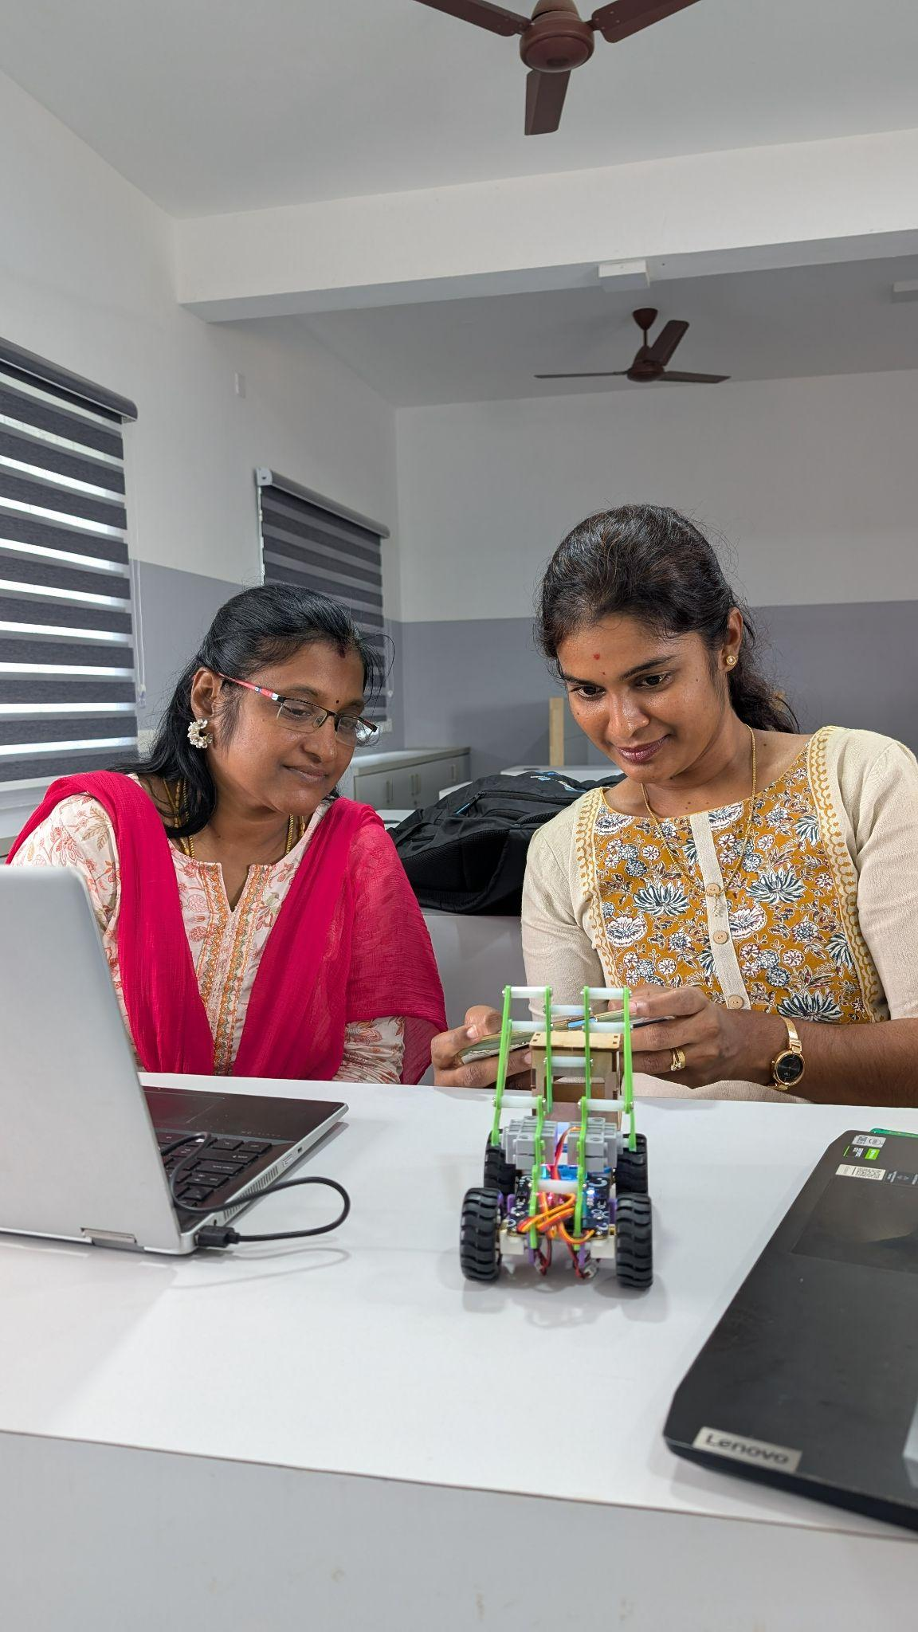


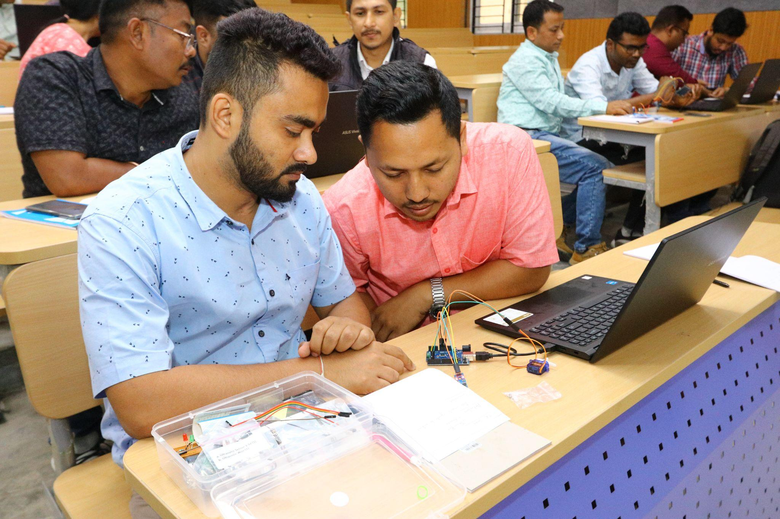
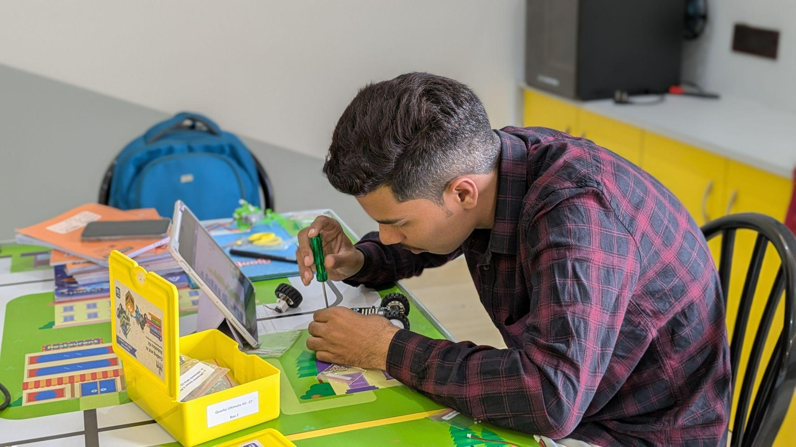
STEM & AI Educators
Upskilling Program
WEEK 1
DATE: 30th July
Presented By:
Academic Lead: Ronak Jogeshwar
Teaching Fellow: Muskan Rajak
Program Manager: Shivani Mahto

Slide 2
WHY AI NATIVE PROGRAM?
Why #AI-Native Educators Need to be Design Thinkers
Great educators don't start
with technology;
they start with people and
the problems that matter.
2

Slide 3
OUTCOMES
Learning Outcomes
Introduction to Design Thinking
Practical Problem-Solving Approach for Educators
Empathy in Design Thinking
Problem Definition Using Design Thinking
Ideation Process
Prototyping, Testing, and Iteration
3

Slide 4
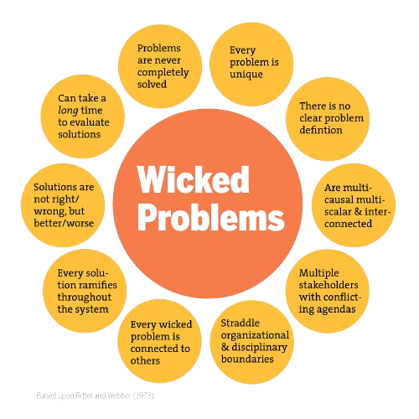
WHY AI NATIVE PROGRAM?
Wicked Problems in Design Thinking
4
Notes:
Reflect real-world challenges with evolving needs.
Require understanding people, not just technology.
Encourage collaboration across diverse perspectives.
Demand experimentation and iterative improvement.
Balance innovation with ethics and sustainability.
Reflect real-world challenges with evolving needs.
Require understanding people, not just technology.
Encourage collaboration across diverse perspectives.
Demand experimentation and iterative improvement.
Balance innovation with ethics and sustainability.

Slide 5
CASE STUDY
Case Study: CEAT Campaign
VIDEO:
https://www.youtube.com/watch?v=lXuBA8K4J64
Problem: Road accidents caused by unsafe driving put families at risk. Children often worry about their parents' safety while they are on the road.
Methodology: CEAT adopted an empathy-driven approach by sharing children's heartfelt messages with their fathers. The campaign used emotional storytelling to influence driver behaviour.
Solution: The initiative encouraged parents to follow safe driving practices and value road safety. It reminded drivers that their families are waiting for them at home.
Output: The campaign increased awareness about responsible driving through an emotional and relatable message. It demonstrated how human-centered design and empathy can inspire positive behavioural change.
5

Slide 6
AI + HUMAN-CENTRED DESIGN
Design Thinking with AI
Human inquiry
Observe learners
Listen to context
Frame the challenge
AI assistance
Generate options
Create examples
Simulate variations
Educator judgment
Critique output
Localize activity
Protect learning intent
Start with people
Use AI as partner
Return to pedagogy
6
Notes:
The question is not ‘How do I use AI?’
The better question is: ‘What learning problem deserves AI helps me solve?’

Slide 7
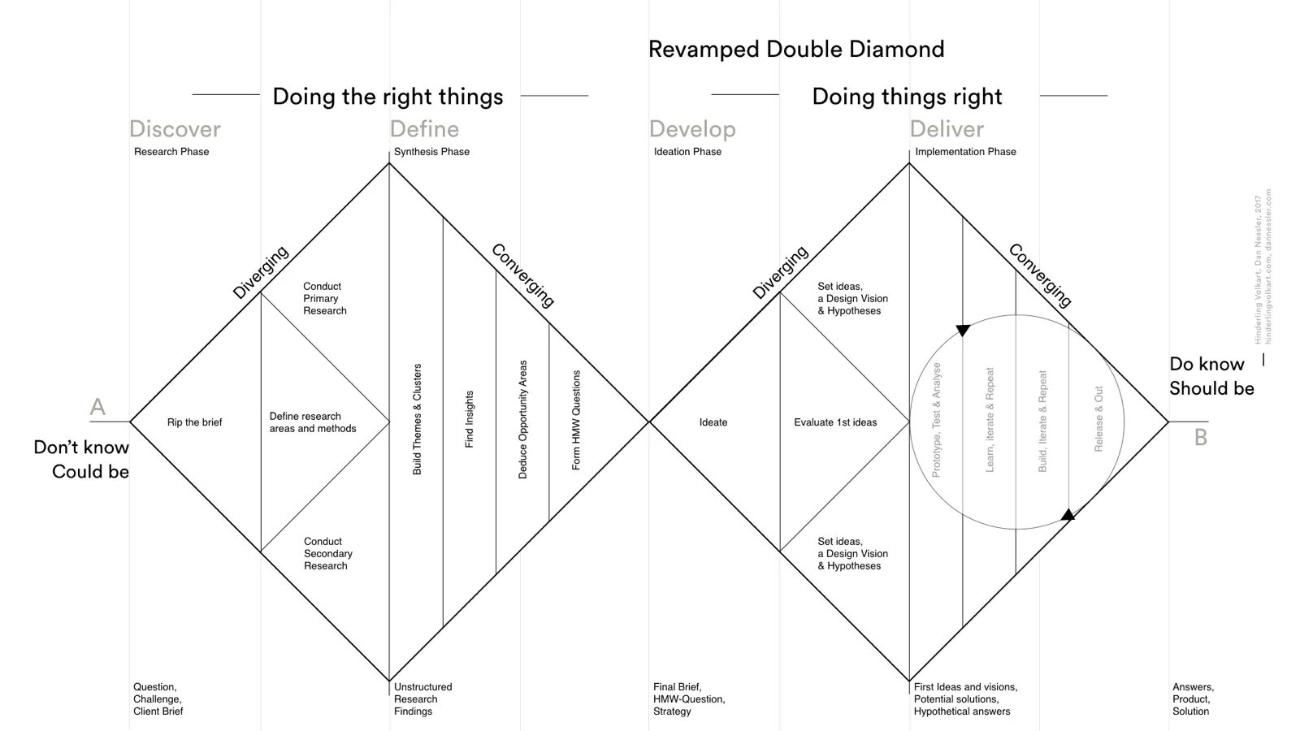
Double Diamond
Design Thinking Framework
5

Slide 8
DESIGN THINKING
Double Diamond Design Thinking Framework
Diamond 1: Understand the Problem
Diamond 2: Develop the Solution
Discover (Diverge) 🔍
Observe and listen to stakeholders.
Gather insights from students, teachers, parents, and the school community.
Ask: What problems exist?
Develop (Diverge) 💡
Brainstorm multiple solutions.
Explore creative ideas and AI-powered possibilities.
Prototype different approaches.
Define (Converge) 🎯
Analyze the information collected.
Identify the root cause of the problem.
Frame a clear problem statement.
Deliver (Converge) 🚀
Test the best solution.
Gather feedback from users.
Refine, improve, and implement the solution.
8

Slide 9
Why in an #AI-Native Program?
9

Slide 10





STAGES
5 Stages of Design Thinking
EMPATHIZE
DEFINE
IDEATE
PROTOTYPE
TESTING
10

Slide 11
EMPATHIZE
Step 1: Empathize
Empathize means understanding learners by observing their experiences, listening to their perspectives, and engaging with their real needs before designing solutions.
OBSERVE :
What do students do?
Design
for
learners,
not assumptions.
LISTEN :
What do students say and feel?
Key Characteristics
ENGAGE :
What do students need and experience?
11

Slide 12
Why Empathize?
12

Slide 13
EMPATHIZE
Why Empathize?
Understand learners beyond their academic performance.
Observe how students think, behave, and interact.
Identify learners' needs, motivations, and challenges.
Replace assumptions with real insights.
Design learning experiences that are relevant and engaging.
Create solutions that address actual learner needs.
13

Slide 14
EMPATHIZE
How To Empathize?
OBSERVE
LISTEN
ENGAGE
- Watch how learners participate and interact.
- Notice what excites, frustrates, or disengages them.
- Look beyond marks to understand behaviors.
- Listen actively without making assumptions.
- Pay attention to both verbal and non-verbal cues.
- Encourage learners to express their thoughts and feelings.
- Talk to learners about their experiences.
- Ask open-ended questions like "Why?" and "Tell me more."
- Create a safe space for honest conversations.
14

Slide 15
DEFINE
Step 2: Define
Once we understand our learners, the next step is to clearly define the real problem before exploring possible solutions.
Makes sense of insights gathered during empathy.
Narrows broad observations into one clear challenge.
Aligns the team around a common problem.
Creates focus before generating ideas.
15

Slide 16
Why Define?
16

Slide 17
DEFINE
Why Define?
Provides clarity by focusing on the most important challenge.
Prevents solving the wrong problem or addressing only the symptoms.
Aligns everyone around a shared understanding of the challenge.
Saves time and effort by directing ideas toward a clear goal.
Creates a strong foundation for meaningful and innovative solutions.
17

Slide 18
DEFINE
How To Define?
IDENTIFY YOUR AUDIENCE
REVEAL NEEDS
ARTICULATE INSIGHTS
Work to express INSIGHTS you developed through the information gathered through empathy and research work
Develop an understanding of the type of person you are designing for – your Audience.
Create and select a limited set of NEEDS that you think are important to fulfill
18

Slide 19
IDEATE
Step 3: Ideate
The Ideate stage is where we generate a wide range of possible solutions to the defined problem. It encourages creative thinking and the exploration of different perspectives before selecting the most suitable approach.
Focuses on possibilities rather than limitations.
Encourages creative and divergent thinking.
Key Characteristics
Explores multiple approaches to the same challenge.
Builds on insights gathered from the previous stages.
Delays judgment until ideas have been fully explored.
Great solutions begin with the willingness to explore many ideas before choosing one.
19

Slide 20
Why Ideate?
20

Slide 21
IDEATE
Why Ideate?
To step beyond obvious solutions
To connect the collective perspectives
To uncover unexpected areas of exploration
To create easy and flexible innovation options
21

Slide 22


IDEATE
How to Ideate?
Ideation is most effective when we suspend judgment, think broadly, and encourage every idea before choosing the best one.
REGULAR BRAINSTORMING
REVERSE BRAINSTORMING
Encourage every idea without criticism.
Build on others' ideas collaboratively.
Aim for quantity before quality.
Capture all ideas for later evaluation.
Ask, "How could we make this problem worse?"
Identify actions or barriers that create the problem.
Reverse those insights to discover innovative solutions.
Reveal hidden assumptions and opportunities.
22

Slide 23
PROTOTYPING
Step 4: Prototyping
The Prototype stage is the process of creating a simple, tangible representation of an idea to explore, demonstrate, and refine a possible solution.
Represents an idea in a simple and practical form.
Focuses on learning rather than perfection.
Key Characteristics
Makes abstract ideas visible and testable.
Encourages experimentation before full implementation.
Provides a basis for gathering feedback and improvement.
23

Slide 24
Why Prototype?
24

Slide 25
PROTOTYPING
Why Prototype?
Validate AI-assisted ideas before full classroom implementation.
Identify strengths, gaps, and opportunities through early experimentation.
Gather meaningful feedback from learners and stakeholders.
Refine solutions based on real classroom experiences.
Build confidence through continuous iteration and improvement.
25

Slide 26




PROTOTYPING
How to Prototype?
A prototype just needs to be good enough to learn from and does not have to be perfect.
KEEP IT SIMPLE
BUILD FOR THE USER
TEST ONE IDEA AT A TIME
ITERATE QUICKLY
- Build the simplest version of your idea.
- Focus only on the core concept.
- Design with the learner's needs in mind.
- Keep the prototype relevant to the problem.
- Decide what you want to validate.
- Avoid testing multiple
assumptions together.
- Gather feedback, improve, and repeat.
- Refine the prototype based on what you learn.
26
Notes:
Build small, test early, learn continuously, and let feedback, not assumptions, shape your final solution.

Slide 27
TESTING
Step 5: Testing
Testing is the process of implementing AI-supported learning experiences, collecting evidence from the classroom, and refining them based on student feedback and outcomes.
Implement the learning activity with students in a real classroom.
Observe student engagement, participation, and learning outcomes.
Key Characteristics
Collect feedback from students and other stakeholders.
Evaluate what worked well and what needs improvement.
Refine the learning experience based on evidence and feedback.
27

Slide 28
Why Test?
28

Slide 29
TESTING
Why Test?
Validate whether the solution improves learner outcomes.
Refine AI-assisted ideas using classroom feedback.
Adapt solutions to meet diverse learner needs.
Identify gaps, opportunities, and unexpected insights.
Build confidence before scaling implementation.
29

Slide 30
TESTING
How to Test?
IMPLEMENT IN THE CLASSROOM
OBSERVE STUDENT EXPERIENCES
COLLECT MEANINGFUL FEEDBACK
REFLECT &
REFINE
Facilitate the activity with students in a real learning environment.
Ask students what helped them learn and what could be improved.
Use classroom evidence and AI insights to improve the learning experience.
Watch how students engage, collaborate, and respond.
30
Notes:
The clearer your problem statement, the more relevant and impactful your ideas will be.

Slide 31
CASE STUDY
Case Study: Solar Demi
VIDEO:
https://www.youtube.com/watch?v=o-Fpsw_yYPg
Problem: Millions of people living in informal settlements lack access to reliable electricity and adequate indoor lighting. This limits daily activities, education, and productivity.
Methodology: The initiative studied community needs and repurposed discarded plastic bottles filled with water and bleach. Local residents were trained to manufacture and install the bottle lights.
Solution: The bottle lights refract sunlight to illuminate homes during the day without electricity. The project also promotes recycling, local employment, and community ownership.
Output: Homes receive free lighting throughout the day, reducing energy costs and improving quality of life. The initiative has been replicated globally as a successful example of frugal, human-centered innovation.
31

Slide 32
CASE STUDY
Case Study: A Liter of Light
VIDEO:
https://www.youtube.com/watch?v=cQCHvO2H0_0
Problem: Many low-income households lack reliable electricity and adequate daytime lighting. This affects safety, productivity, and quality of life.
Methodology: The initiative uses plastic bottles filled with water and bleach, installed in rooftops to refract sunlight. Local communities are trained to build and install the lights.
Solution: The bottle lights provide free daytime illumination without using electricity. The project also promotes recycling and community participation.
Output: Homes become brighter while reducing energy costs and plastic waste. The initiative improves living conditions through a simple, sustainable innovation.
32

Slide 33
MATERIAL
Learning Resources
The learning doesn't stop when the session ends—these resources will help you keep building your skills.
Short Videos
Constructionism vs Instructionism
Learning through Projects
Engagement not Explanation
Reading
Wicked Problem in Design Thinking
Meeting Roles
33

Slide 34


Slide 35


Slide 36


