Slide 1
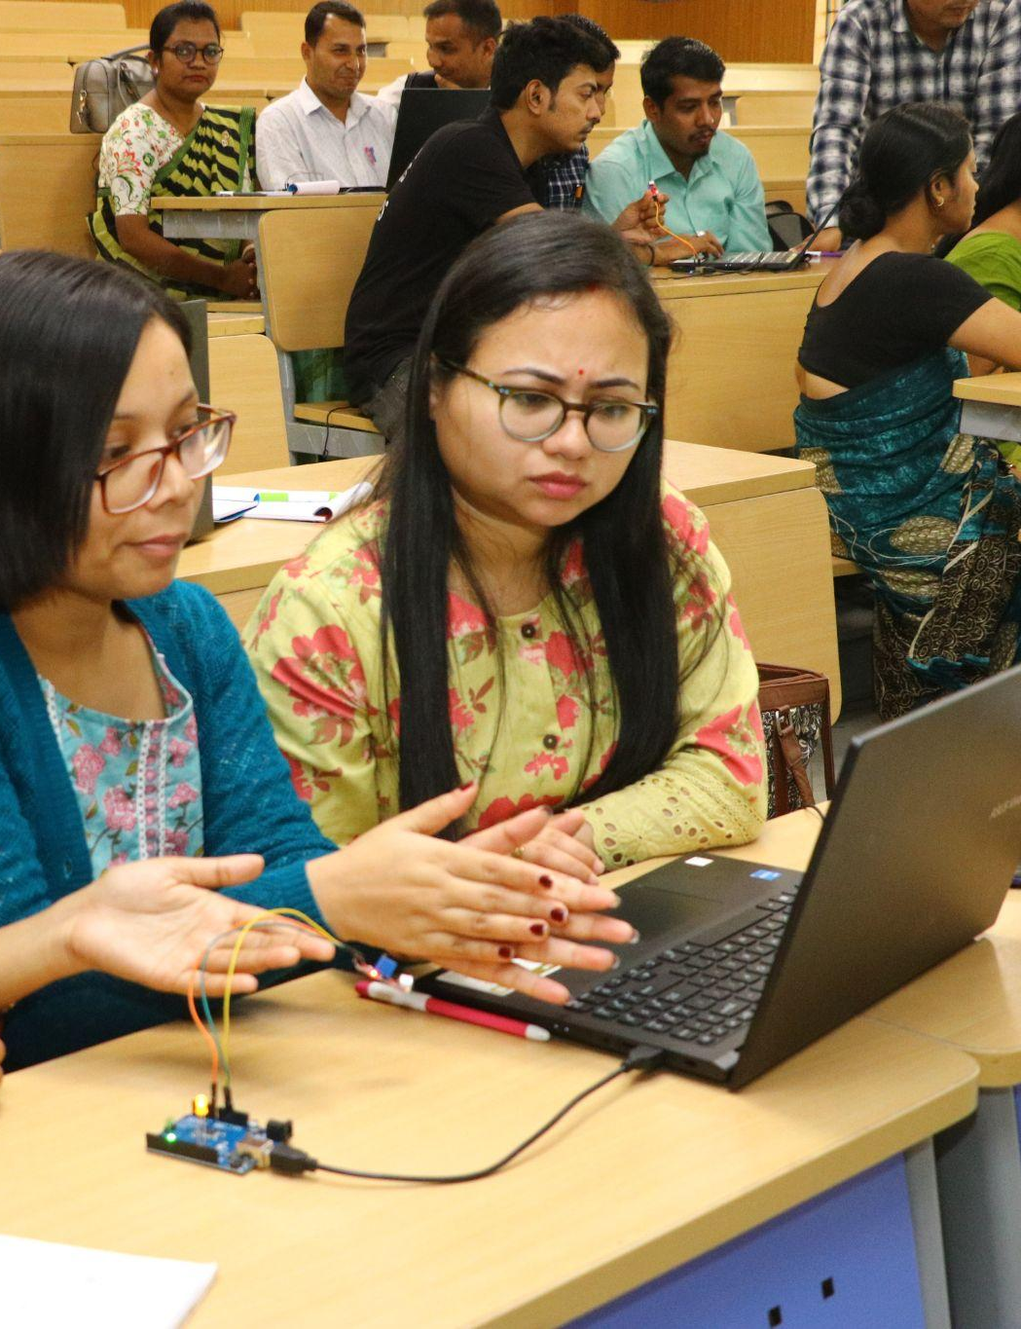
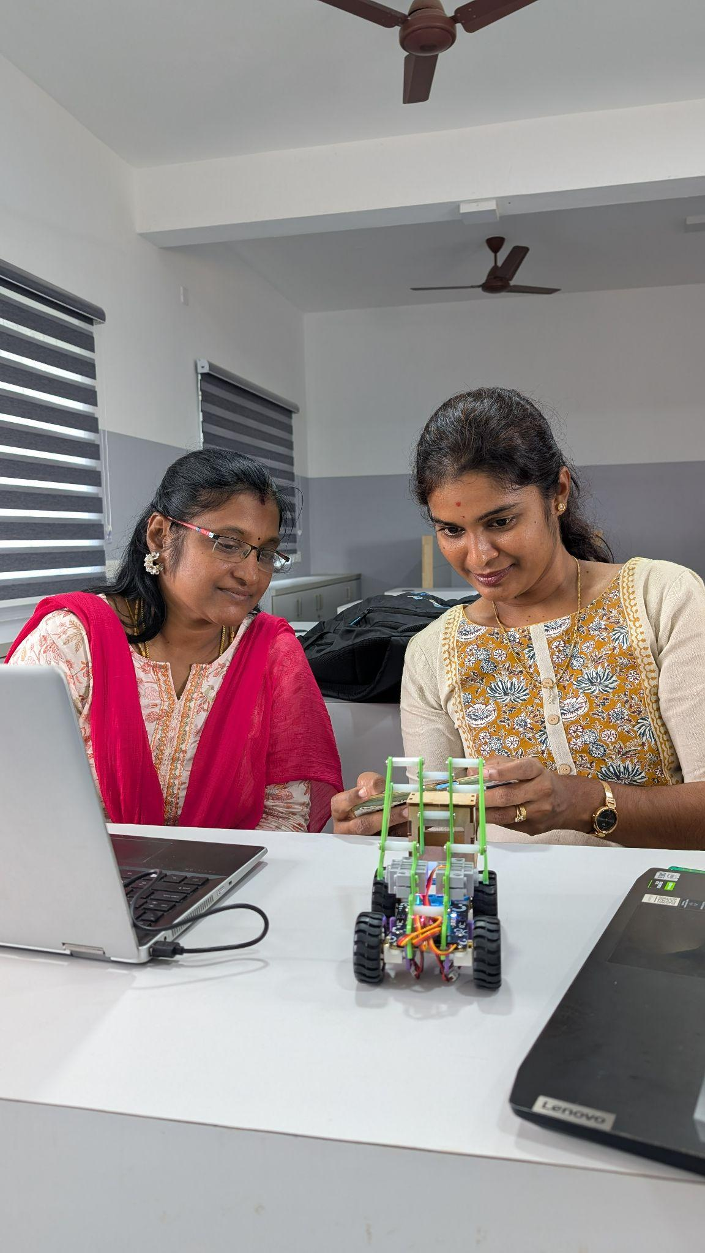


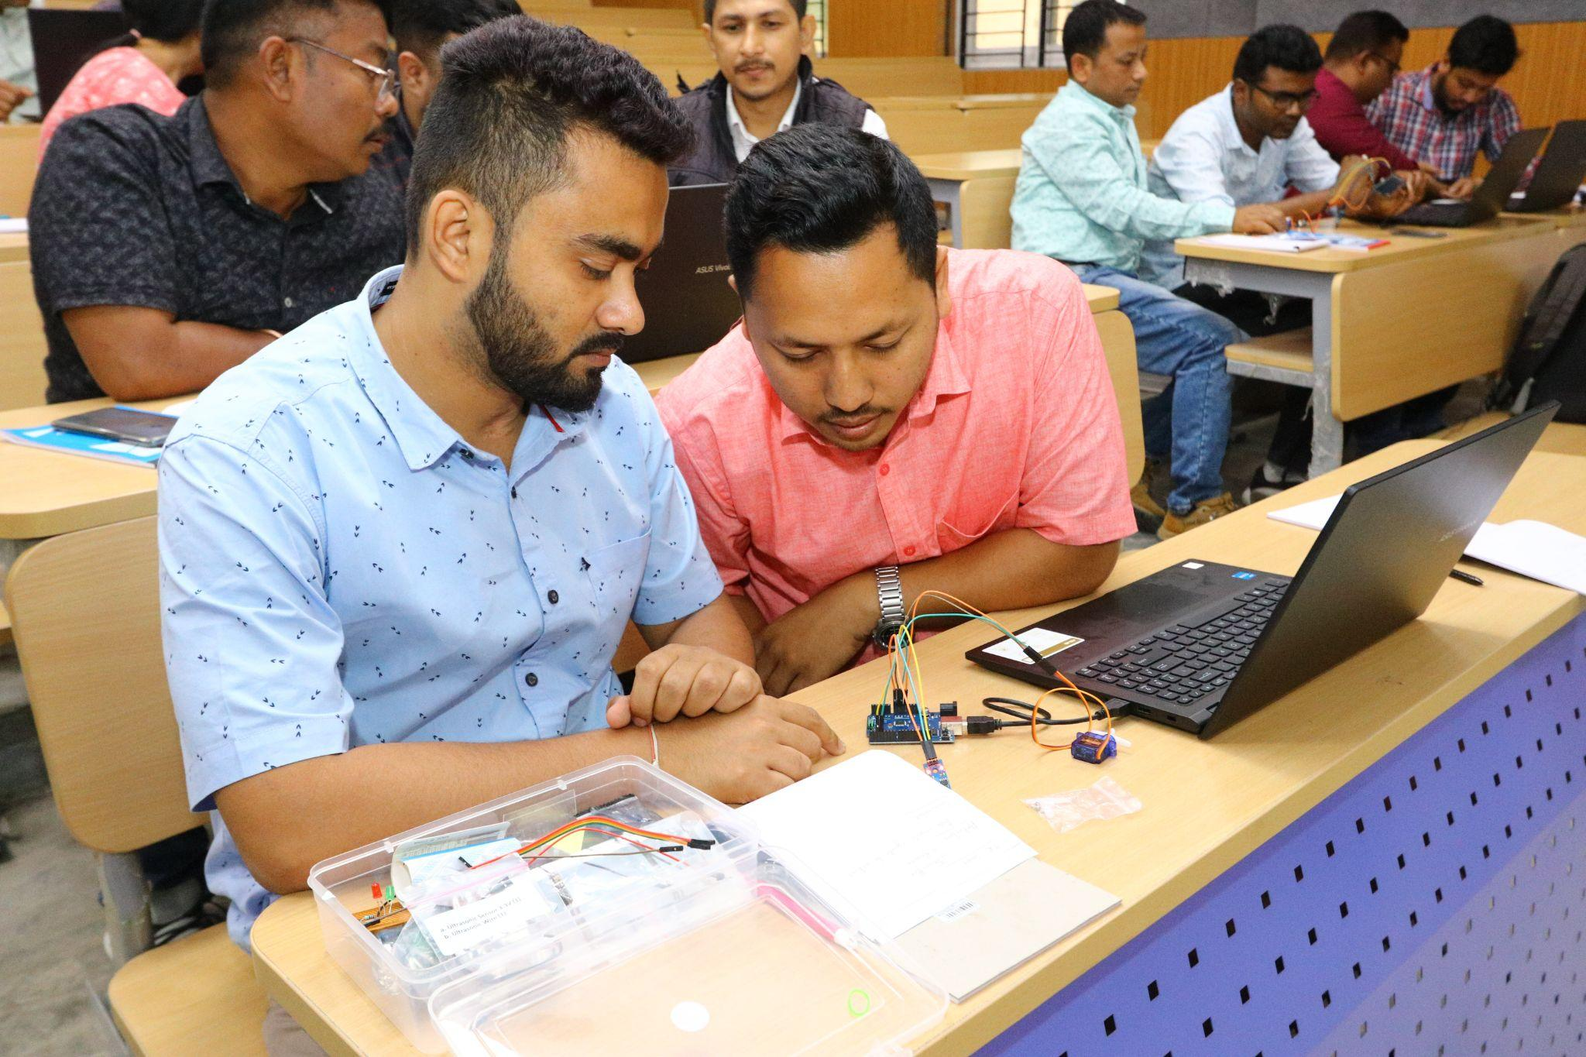
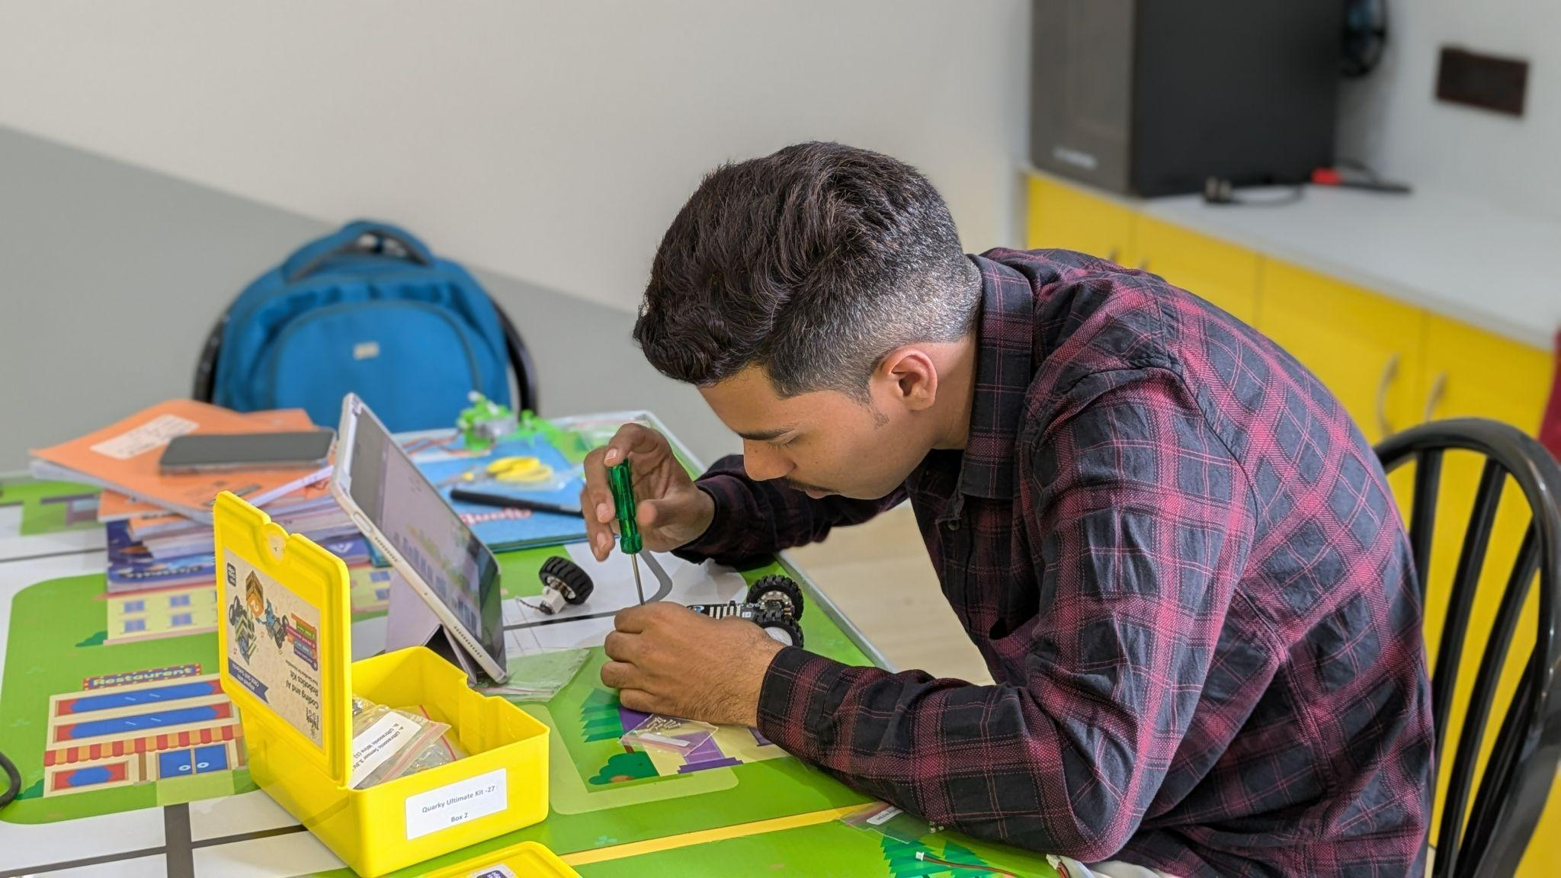
STEM & AI Educators
Upskilling Program
WEEK 1
DATE: 1st August
Presented By:
Academic Lead: Ronak Jogeshwar
Teaching Fellow: Muskan Rajak
Program Manager: Shivani Mahto

Slide 2
CASE STUDY
Case Study: Paperfuge
VIDEO:
https://youtu.be/pPePaKnYh2I?si=NnlvnA9xG52y7-8f
Problem: Conventional laboratory centrifuges are expensive, bulky, and require electricity, making disease diagnosis difficult in remote and low-resource settings.
Methodology: Researchers at Stanford studied an ancient whirligig toy and applied its spinning mechanism to create a lightweight, hand-powered paper centrifuge costing about $0.20.
Solution: The Paperfuge rapidly separates blood components without electricity, enabling field diagnosis of diseases such as malaria and anemia. It is portable, inexpensive, and easy to use.
Output: The innovation performs similarly to laboratory centrifuges for many diagnostic tasks while dramatically reducing cost and increasing healthcare accessibility in underserved regions. It has become a leading example of frugal innovation and human-centered design.
2

Slide 3
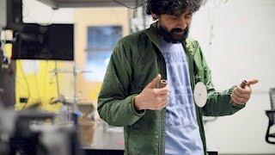

Slide 4
Design Thinking In Action
Design Thinking is best understood by doing.
OBJECTIVE
Apply the Design Thinking process to a real classroom challenge.
Collaborate with peers to generate innovative solutions.
Explore AI tools independently.
Build a classroom-ready ideation activity.
3

Slide 5
Studio Norms
During Today's Studio
Be curious, not critical.
Focus on understanding the problem before solving it.
Encourage every team member to contribute.
Build on each other's ideas.
There are only better iterations, no perfect solutions.
4

Slide 6





EMPATHIZE
Recap: The Design Thinking Process
A human-centered, iterative approach to solving complex problems.
EMPATHIZE
DEFINE
IDEATE
PROTOTYPE
TESTING
Understanding
learners
Frame the right problem
Generate multiple ideas
Build a simple solution
Gather feedback and improve
5

Slide 7
Design Thinking Exercise
https://youtu.be/wZCIDpt3nBU
VIDEO:
WHILE WATCHING
Observe
What is the actual problem?
Who are the stakeholders?
What constraints exist?
What opportunities can you identify?
6

Slide 8
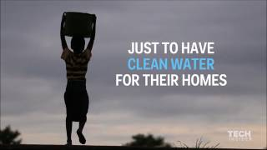

Slide 9
Breakout Room
Activity Duration: 10 Minutes
7

Slide 10
Discussion
Activity Duration: 5 Minutes
8

Slide 11
CASE STUDY
Case Study: Hippo Water Roller
VIDEO:
https://www.youtube.com/watch?v=sgWWXSEw0Dc
Problem: People in rural communities spend hours carrying heavy water containers over long distances. This limits time for education, work, and other daily activities.
Methodology: The Hippo Water Roller is a large rolling drum that transports water by being pushed or pulled. Its durable design allows users to carry much larger quantities with less physical effort.
Solution: The device makes water collection faster, easier, and less physically demanding. It reduces the burden on women and children, who are often responsible for fetching water.
Output: Communities save time and energy while gaining better access to clean water. The innovation improves quality of life and supports health, education, and economic productivity.
15

Slide 12
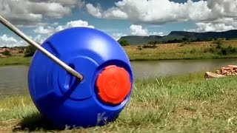

Slide 13
BREAKOUT PROMPT
Design Thinking Canvas
Complete the following
Empathize
Who is facing the problem?
Define
What is the real challenge?
Ideate
Generate at least 2 ideas.
Prototype
Select one solution.
Test
How would you evaluate the success?
14

Slide 14
BREAKOUT PROMPT 1A
How can you identify student problems that AI can help solve?
1.Forget Homework ,Material.
2.Group discussion , unable to answer due to underconfidence or not comfortable.
3.Health Issue ,bad posture.
4.Time Management
5.Road safety for students.
6.
10

Slide 15
How can you identify student problems that AI can help solve?
1. Spot the Signs, Common Mistakes: Whole classes failing the same exact concept.Bottlenecks:
2. Delayed feedback because grading takes you too long.Silences: Students struggling alone during late-night study hours.
3.Track Academic Bottlenecks (The "Stuck" Points)
Concept Blindspots: Look for specific topics where a large percentage of students consistently fail or score poorly on assessments.
Prerequisite Gaps: Identify students entering a course without the foundational knowledge needed to keep up.
Feedback Delays: Notice when large class sizes prevent you from giving immediate, detailed feedback on essays or complex assignments.
4. Monitor Behavioral and Engagement Signals
Disengagement Triggers: Track when student participation drop
5. Match with AI Tools Adaptive Learning Dashboards :These systems help track real-time visual metrics, highlight exact concepts where student scores consistently drop, and automatically personalize study paths to close performance gaps.

Slide 16
BREAKOUT PROMPT 2A
What are some common challenges teachers face that students could solve using AI?
PROBLEM
Students learn in different space and in different style
Time constraint
Students becoming passive learners and too dependant on technology
Students using AI to write the assignments.
DEFINE
Planning a lesson, making it effective (one plan fits all)
SOLUTIONS
Use AI tools to simplify and arrange topics based on different age groups
Come up with a tool to detect plagiarism
FINAL SOLUTION
Use AI tools to simplify and arrange topics based on different age groups
11

Slide 17
BREAKOUT PROMPT 3A
Imagine you are creating an AI Curriculum. Where would you begin and why?
Aim- to create Digital Literacy.
AI Curriculum for Elders
AI Curriculum for Students
1. Identify what they need from AI
2. Elders need assurance.
3. Need it to be simple and accessible.
1. Identify the needs.
2. Figure out the cybersecurity and safety aspect.
3. Cognitive ability is reducing, so need to focus about the challenges. Ethics need to be taught.
4. AI is a tool. Need to teach them how to use it.
5. Should clarify pros and cons and explain ethical issues. Create limits and parental controls.
1. Identify their age group, their coding and technical knowledge. Will decide how and what we teach them. We should also identify interest categories and how to make the curriculum engaging and fun.
2. Learning by doing
3. How to integrate AI in all subjects.
12

Slide 18
BREAKOUT PROMPT 5A
Who else in the school community should we ask about their challenges? How can AI help solve their problems?
Security Staff
  Problem: Manual management of visitor login and logout.
  Idea: AI Logging of Visitors using face recognition
Gardening Staff
  Problem: Plant based diseases
  Idea: App tracking Plant health using camera and good ML models
School Admin
  Problem: Keeping track of the homework and assignments of students and find out patterns in it to find best learning method for student
  Idea: AI based text recognising dashboard.
For transport Staff
  Problem: Transport staff has to wait for students at bus stop
  Idea: Live GPS tracking of bus which pings the parents about bus position
13

Slide 19
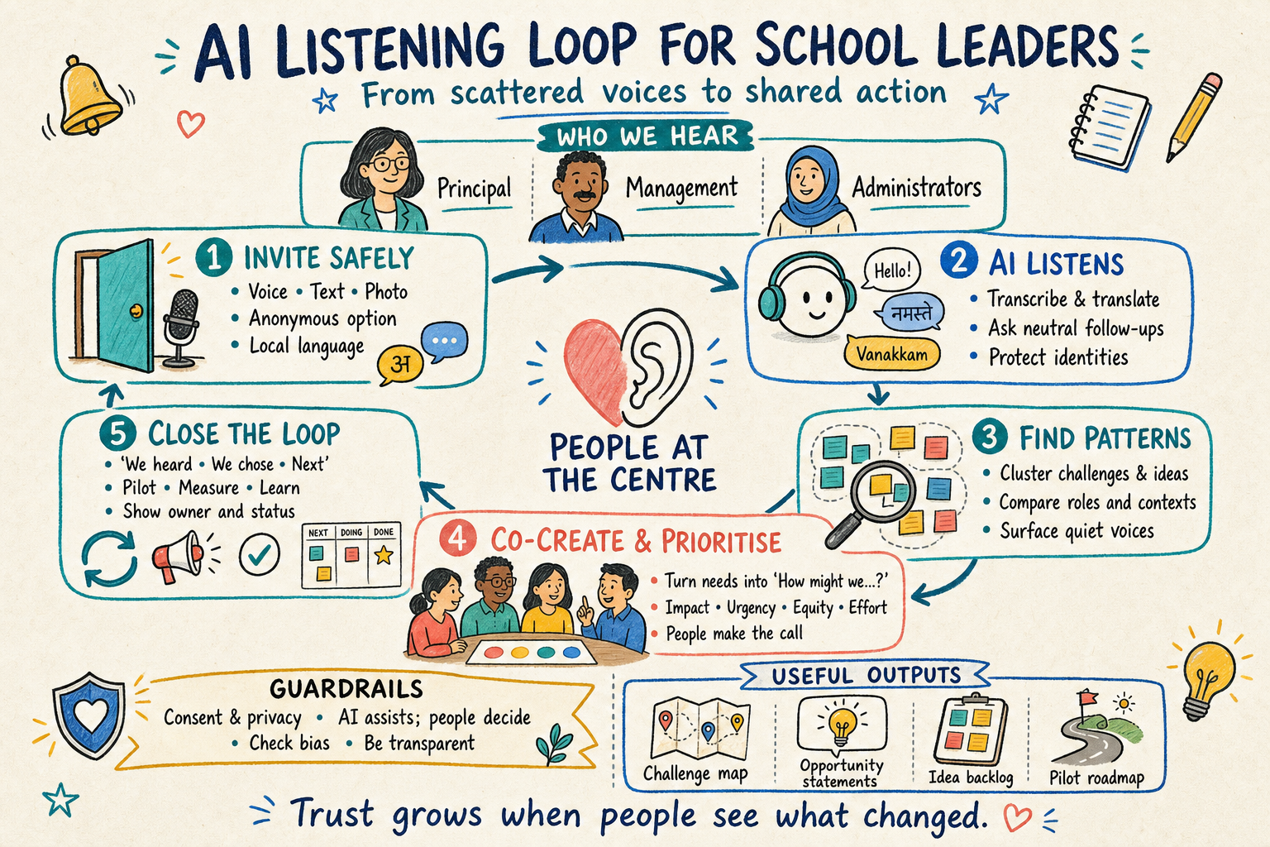
BREAKOUT PROMPT 4A
How can AI help collect challenges and ideas from school leaders, such as the principal, management, and administrators?
I
13

Slide 20
BREAKOUT PROMPT 5A
How can you identify student problems that AI can help solve?
Where the signals come from
Error patterns rather than grades - the same misconception recurring across a cohort tells you far more than a mark distribution. Item-level analysis of assessments, and the questions students actually ask (or ask each other, or ask a chatbot), are the richest sources.
Latency points - anywhere the gap between a student's attempt and useful feedback is measured in days or weeks.
Abandonment points - where students stop: the assignment nobody starts, the reading nobody finishes, the lab report that always arrives late.
Student voice, gathered structurally - brief "what got you stuck this week" prompts, exit tickets, or short interviews. Students usually locate the friction precisely; they just aren't asked.
Teacher pain - tasks staff describe as tedious are often symptoms of a student problem (mass identical feedback usually means the feedback isn't reaching anyone).
13

Slide 21
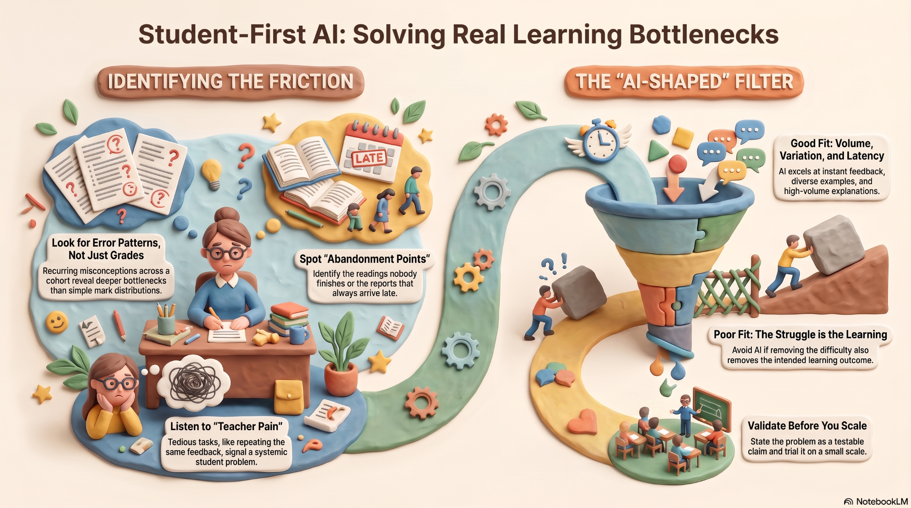
BREAKOUT PROMPT 5A
How can you identify student problems that AI can help solve?
13

Slide 22
Discussion
Activity Duration: 10 Minutes
6

Slide 23
MATERIAL
Learning Resources
The learning doesn't stop when the session ends—these resources will help you keep building your skills.
Short Videos
Lifesaving Scientific Tools Made of Paper
Foldscope: The Paper Microscope
33

Slide 24





SELF-EXPLORATION
AI Self-Exploration
Explore any AI tool independently
GEMINI
CHATGPT
CLAUDE
COPILOT
PERPLEXITY
Empathy begins with curiosity—observe carefully, listen actively, and understand deeply before designing solutions.
16

Slide 25
GUIDELINES
Assignment Submission
Please follow these guidelines while submitting your assignments:
Submit by Wednesday, 11:59 PM (IST), unless notified otherwise.
Upload your assignment slides after the Assignment template in corresponding lecture slides shared with you, following the prescribed format.
Ensure submissions are complete, clearly named, and on time.
Include your Name, Roll No., Elective, and team details (as applicable).
Clearly define your Theme/Problem Statement.
Keep a personal backup of all submitted files.
Report any technical issues before the submission deadline.
25

Slide 26
Assignment 2a Template
REFLECTION
What problem I want to solve for : Identify a classroom problem, frame it as a student-centered design challenge
Add your answer here…
27

Slide 27
Assignment 2b Template
REFLECTION
Prepare a short ideation plan in 1 slide using AI tools.
Add your answer here…
28

Slide 28
CASE STUDY
JUMP PUMP
VIDEO:
https://www.youtube.com/watch?v=Yv6OQ3veu48
Problem: Children in rural schools often do not wash their hands because traditional hand pumps are heavy and difficult to operate. Poor hand hygiene increases the spread of diseases such as diarrhea.
Methodology: Designers observed that children enjoy jumping and playing. They redesigned the traditional hand pump into a foot-operated Jump Pump that uses children's jumping motion to draw water.
Solution: The Jump Pump makes hand-washing fun, easy, and accessible for children. It encourages regular hand-washing before meals without requiring excessive physical effort.
Output: More children wash their hands with soap, improving hygiene and reducing the risk of waterborne diseases. The innovation demonstrates how human-centered design can transform everyday challenges into engaging solutions.

Slide 29


