Slide 1
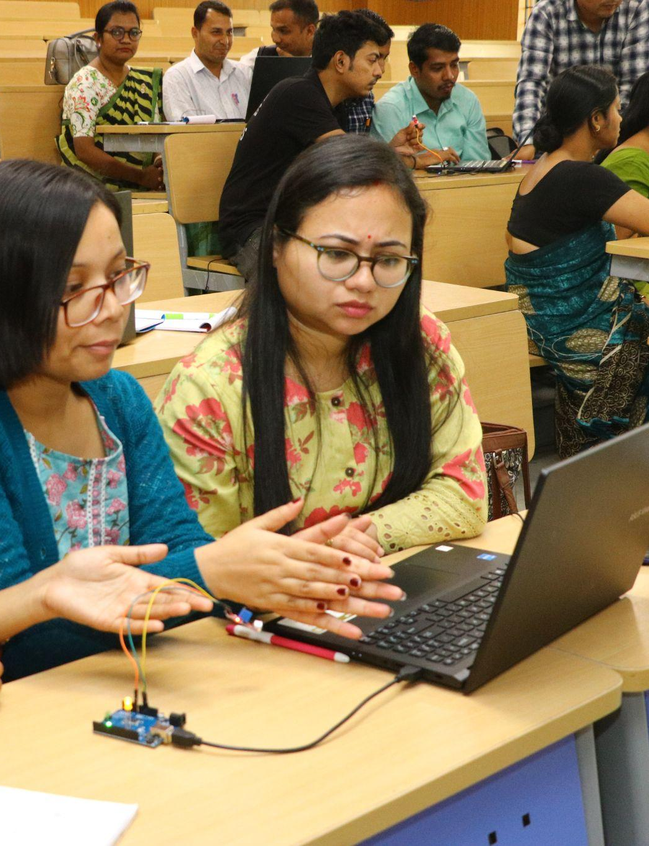

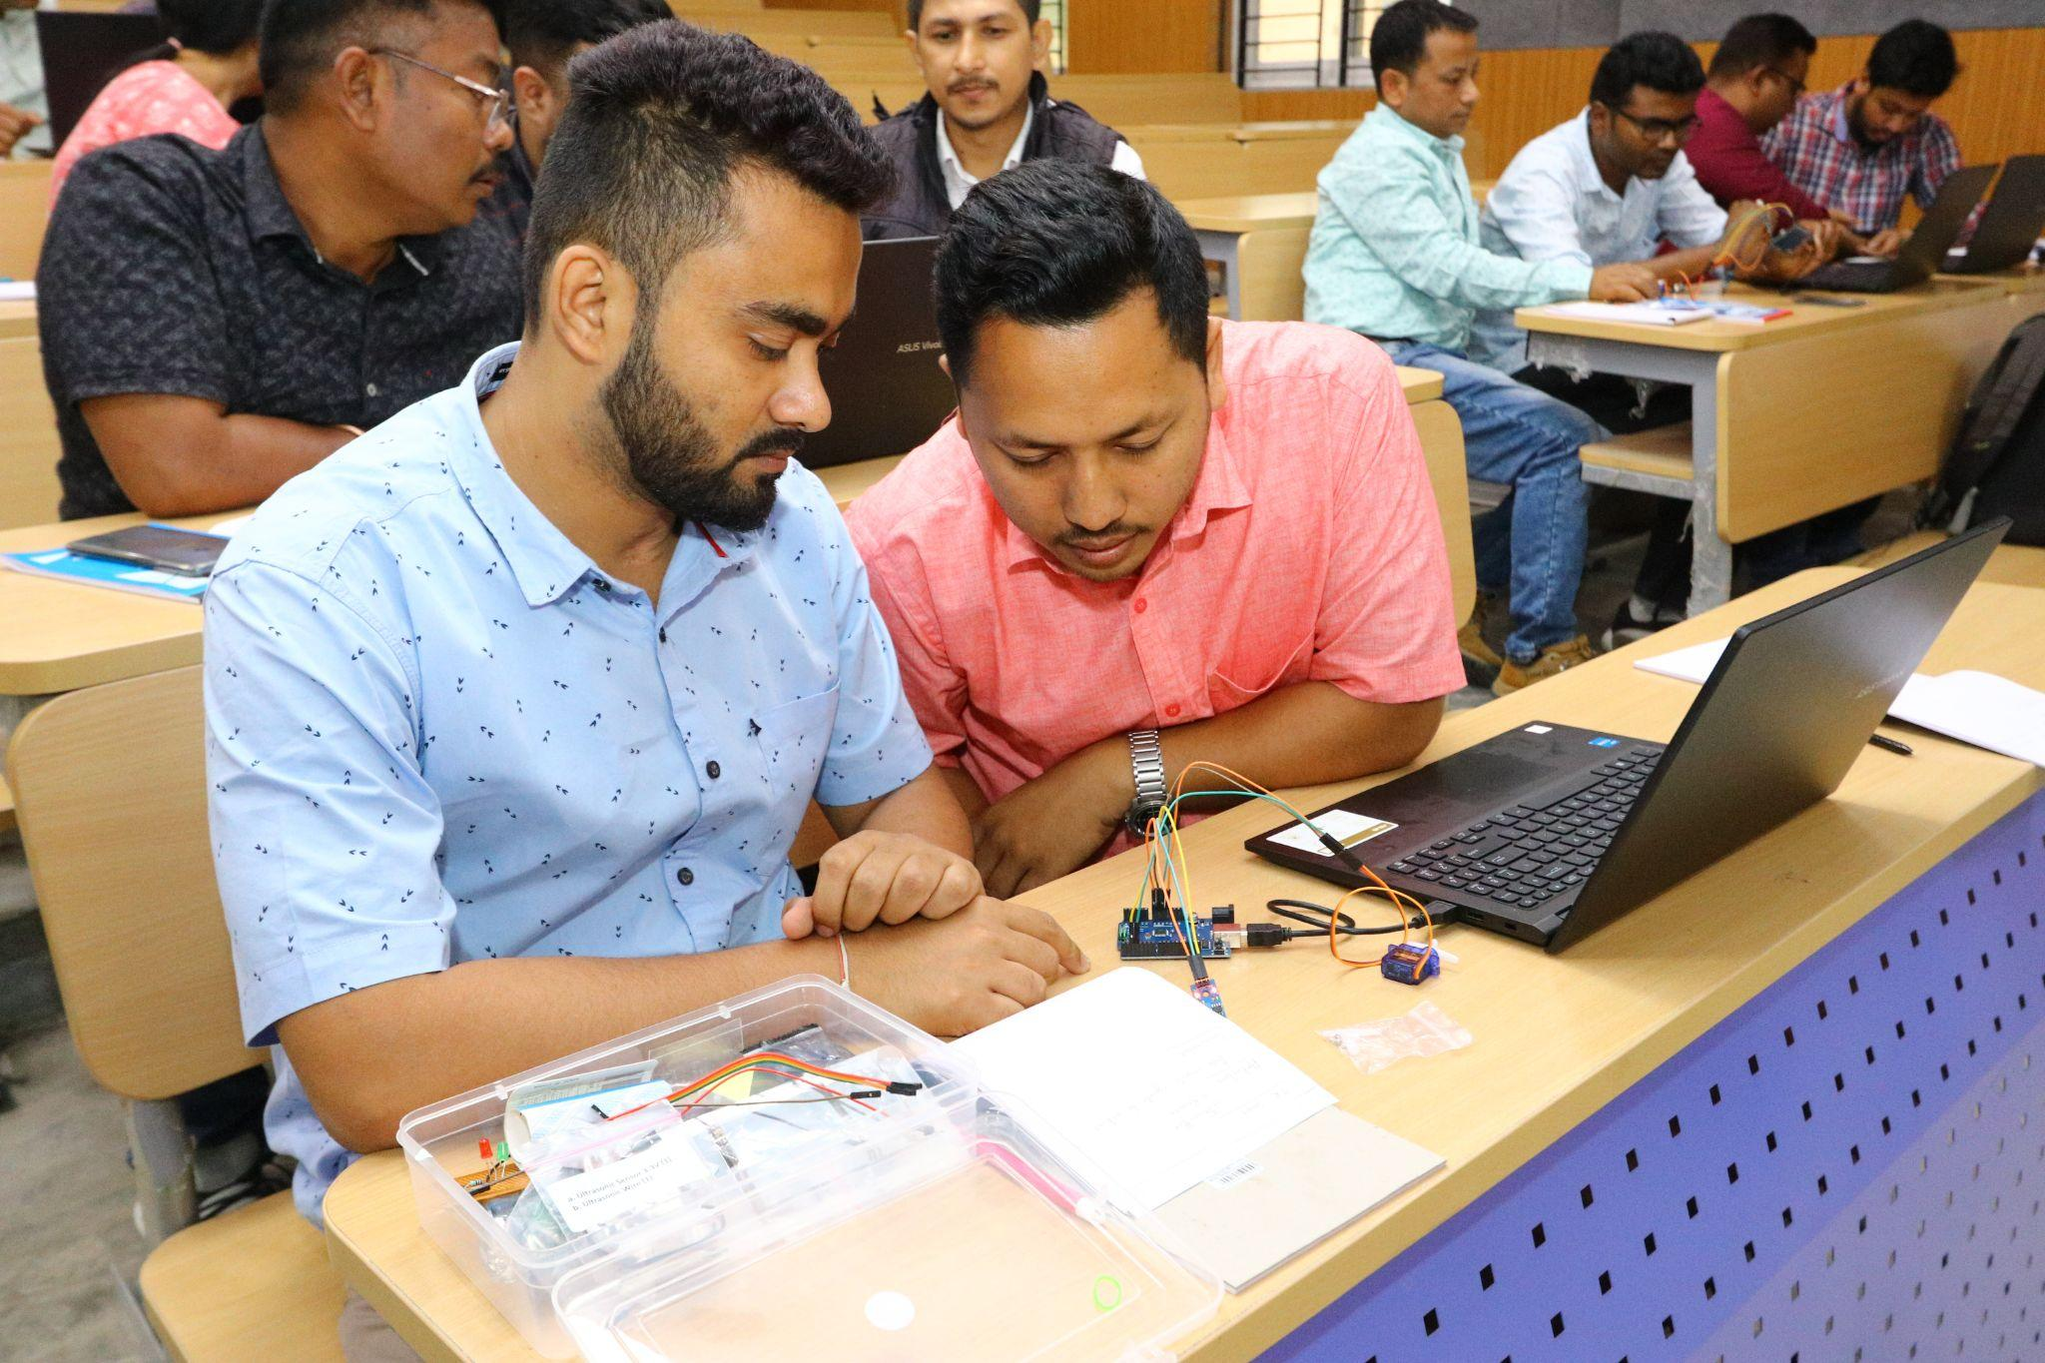

STEM & AI Educators
Upskilling Program
ORIENTATION
DATE: 29th July
Presented By:
Academic Lead: Ronak Jogeshwar
Teaching Fellow: Muskan Rajak
Program Manager: Shivani Mahto

Slide 2
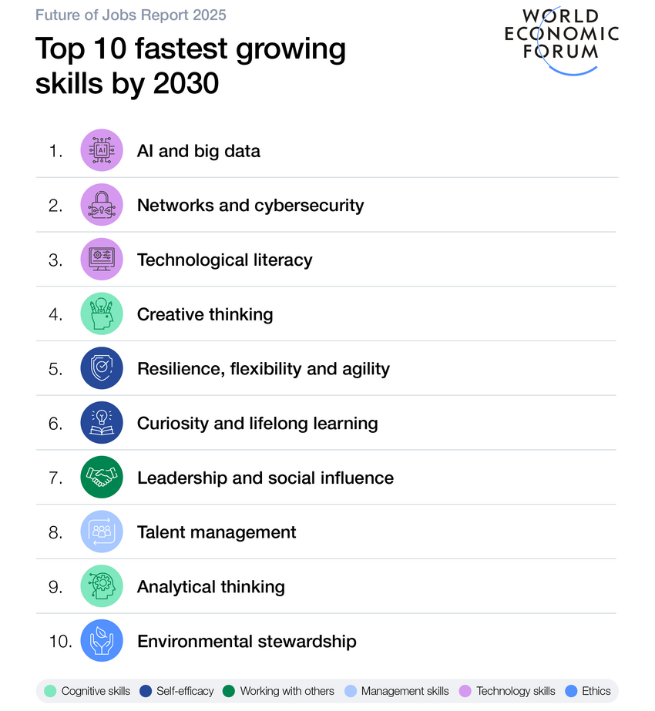
FUTURE OF WORK SIGNAL
Future work skills demand strategic educators with expertise in Applied AI
WEF signals show a future shaped by both technical fluency and human problem-solving.
If these are the signals by 2030, educators preparing learners for 2050 need more than tool training. They need strategic skills and values
Consistency
Completion
Cognition
Collaboration
Communication
Courage
#AI-Native Program

Slide 3
CHALLENGES
Why Now?
1
Empowering educators for AI-native learning
2
AI-ready teachers, future-ready classrooms
Opportunities
3
From tools to transformation
4
Building future-ready educators
02

Slide 4
WHY AI NATIVE PROGRAM?
Question that keeps us awake
1
Build AI-native educators
How do educators convert AI, robotics, coding, electronics, design thinking, entrepreneurship, and experiential learning from buzzwords into real classroom practice?
2
Develop STEM confidence
3
Create future-ready classrooms
4
Foster innovation and creativity

Slide 5
OUTCOMES
Ursa Major
By the end of 100 days participants will:
Design AI-enabled learning experiences
Create classroom-ready resources
Build STEM/AI programs
Develop a Capstone Project
Use AI productively and ethically
Join an AI-Native educator community
03

Slide 6
PHILOSOPHY
Learning Philosophy
1
5
1
2
3
4
Agency before mastery
Programs over one-time events
Human Intelligence + AI
Creative learning
Evidence through capstones
04

Slide 7
FOUNDATION
THEORY OF CHANGE
IF educators are supported to become AI-native and STEAM-confident
HOW?
How is Theory of Change relevant here?
THEN they can transform technology into meaningful classroom learning
BECAUSE they gain the right mindset, tools, and confidence
Notes:
The program is designed to turn this theory of change into classroom practice.

Slide 8
COMMITMENTS
Participant Commitments
To make the most of this 100-day journey, every participant is expected to commit to the following expectations.
Consistency
Completion
Cognition
Attend all sessions and stay engaged throughout the journey.
Submit weekly assignments and upload all required artifacts on time.
Use AI responsibly while applying your own critical thinking and creativity.
Collaboration
Communication
Courage
Learn with peers, share ideas, and contribute respectfully.
Follow the program schedule and stay informed about updates.
Build a practical capstone that creates real educational impact.
Your commitment will shape your growth throughout these 100 days.

Slide 9
SCHEDULE
Weekly Schedule
This program follows a structured weekly rhythm that balances learning, practice, reflection, and project development.
Element | Timing | Format | Purpose
Weekly assignment | 2-3 hours of asynchronous work. Due before the class every Wednesday midnight | Reflection / artifact / upload | Short assignments that gradually build toward the final capstone project
Tuesday - 1 Special Session | (5:00pm - 6:00pm) | 8th September | Special Session on Arduino And project sessions
Thursday | Online (1 hour) (5:00pm - 6:00pm) | Lecture / conversation / Expert session | Introduce concepts, examples, case studies, best practices, and frameworks
 |  | Read/Watch/Listen | Plus-Minus-Delta survey Given after Thursday class
Saturday | Online (1.5 hours) (5:00pm - 6:30pm) | Studio / workshop / application | Apply the ideas through tools, templates, peer work, and project design
 |  | Assignment | Plus-Minus-Delta survey Given after Saturday class
Capstone | Asynchronous Team Work | Office hours + troubleshooting | Build and refine participant projects
Final Showcase | Final Week | Presentation + reflection | In person event. Share projects, portfolios, and next steps

Slide 10
THE 100-DAY ARC
Program Structure
The program is designed as a learning arc
Orientation
Electives
Three tracks
Day 1
Week 10–11
Design thinking
Learning design Systems
Capstone work
Office hours Submission
Week 1–3
Week 12–13
AI learning tools, Activity cards Educator demos
Contingency
Showcase prep
Week 4–5
Week 14
Coding + AI/ML
Microcontrollers
Google + creative learning
Graduation
Final showcase
Week 6–9
Day 100
July 29
October 25
By following this weekly rhythm consistently, you'll steadily build the skills and confidence needed to complete your capstone successfully.

Slide 11
GUIDELINES
Assignment Submission
Please follow these guidelines while submitting your assignments:
Submit by Wednesday, 11:59 PM (IST), unless notified otherwise.
Upload your assignment slides after the Assignment template in corresponding lecture slides shared with you, following the prescribed format.
Ensure submissions are complete, clearly named, and on time.
Include your Name, Roll No., Elective, and team details (as applicable).
Clearly define your Theme/Problem Statement.
Keep a personal backup of all submitted files.
Report any technical issues before the submission deadline.

Slide 12
HAVE A DOUBT?
Questions? Concerns? Need Guidance?
We're committed to making your experience smooth and successful—here's how you can connect with us.
Academic queries, assignments, learning or session support
Connect with Muskan Rajak
muskanrajak@thestempedia.com
Program coordination, schedules, logistics, or administrative support
Connect with Shivani Mahto
shivanimahto@thestempedia.com
We're just a message away—don't hesitate to reach out.

Slide 13
MATERIAL
Learning Resources
Podcast
Generative AI and Creative Learning: Concerns, Opportunities, Choices

Slide 14
NAME:
UID:
Assignment 1 Template
REFLECTION
What kind of STEM/AI educator do I want to become?
PROBLEM STATEMENT
One School/Classroom problem you care about?
Add your answer here…
Add your answer here…

Slide 15
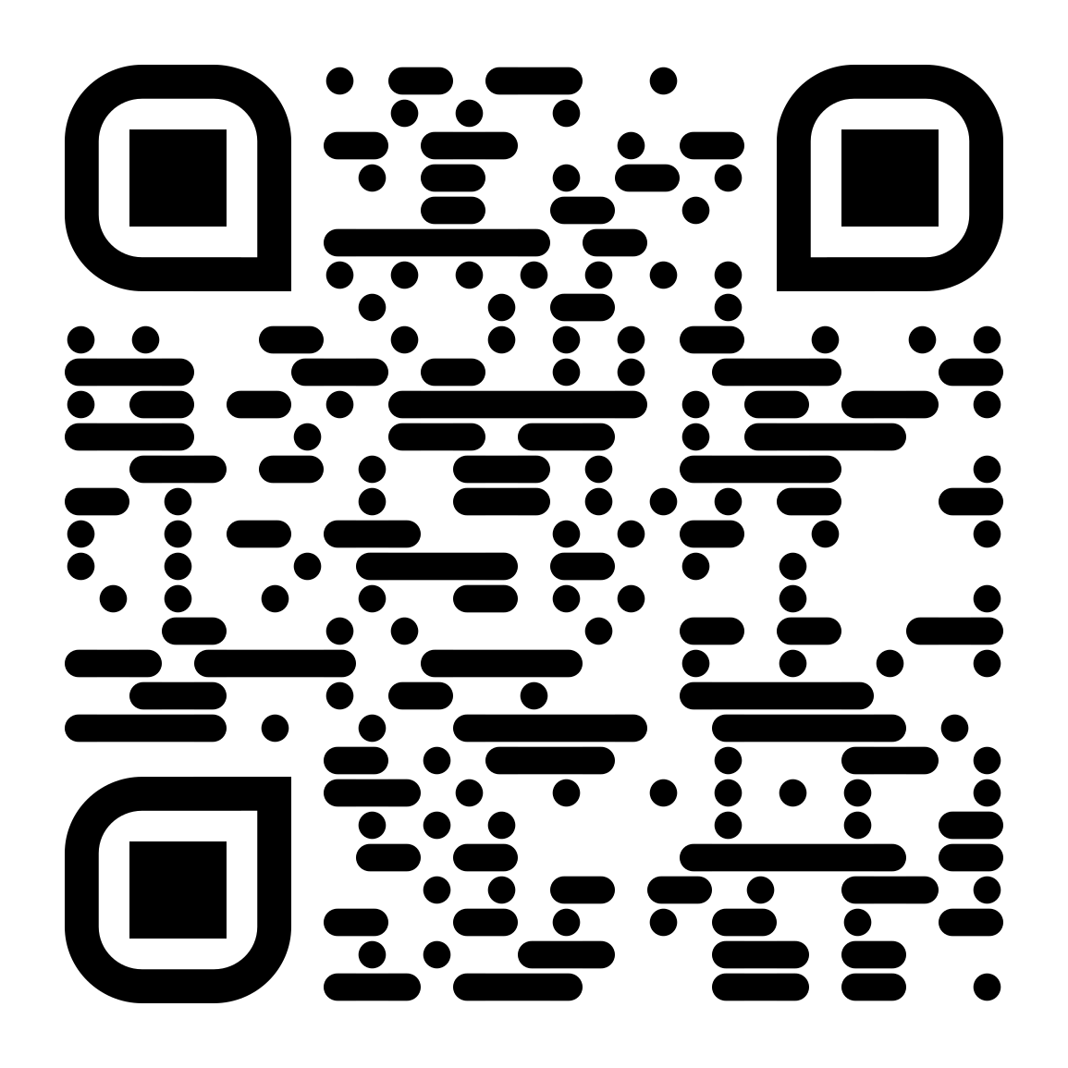
Pre-Program Assessment
Participant Details Form

